Slide 1
Enhancing Accessibility
AI & Machine Learning
Bri McGowan
Notes:
October is a festive month! Happy almost White Cane Day! National Disability Employment Awareness Month! BelatedIndigenous Peoples' Day! Please put questions in the chat.

Slide 2
Agenda
Introductions
Overview
AI / ML Community
Prevention, Intervention, & Reinvention
Q&A

Slide 3
Introduction

Slide 4


Who are we?
Brianna R. Gomez McGowan (she/her)
IT Specialist
Piscataway Land
Notes:
Describe pics

Slide 5
Overview

Slide 6
Accessibility
“Accessibility” means the design, construction, development, and maintenance of facilities, information and communication technology, programs, and services so that all people, including people with disabilities, can fully and independently use them.
Executive Order on Diversity, Equity, Inclusion, and Accessibility in the Federal Workforce

Slide 7
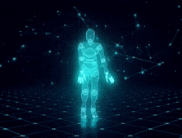
Artificial Intelligence
“Artificial intelligence” is the simulation of human intelligence processes by machines, especially computer systems. Specific applications of AI include expert systems, natural language processing, speech recognition and machine vision.
TechTarget
Dancing AI

Slide 8

Machine Learning
“Machine Learning” is a branch of artificial intelligence (AI) and computer science which focuses on the use of data and algorithms to imitate the way that humans learn, gradually improving its accuracy.
IBM
Nodes and Edges Web

Slide 9
AI / ML Community

Slide 10
Strengthening AI & ML Communities
Open Source
Emerging Tech
For the People
Radical Collaboration
Create accessible systems for people to contribute to open source machine learning and artificial intelligence use cases and future possibilities
Innovation & Iteration
Emerging technologies that are designed and developed to be accessible and robust
Future of the Internet
What does a safe and accessible internet look like for the people, with, and by people of all abilities?

Slide 11

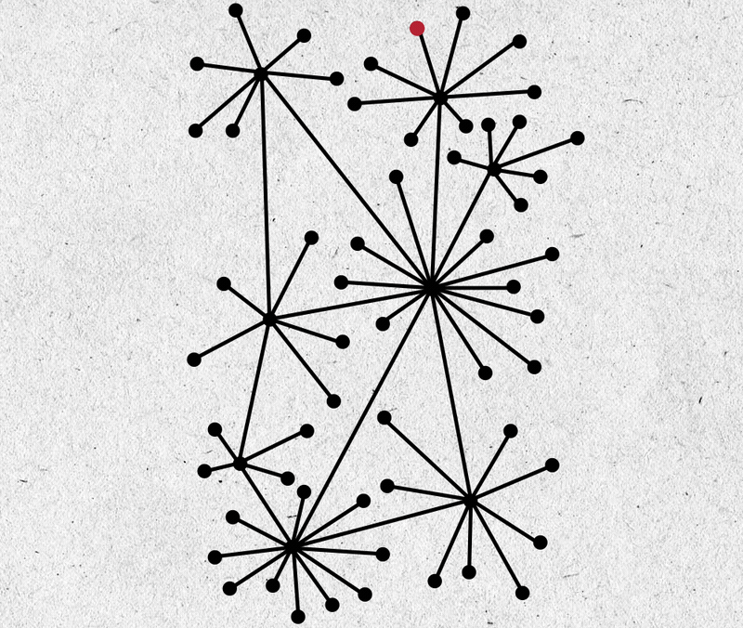

Community Systems
Centralized
Decentralized
Distributed
In a centralized system, all users are connected to a central network owner or “server”.
Decentralized systems don’t have one central owner. Instead, they use multiple central owners, each of which usually stores a copy of the resources users can access.
In a distributed system, users have equal access to data, though user privileges can be enabled when needed. The best example of a vast, distributed system is the internet itself.
Notes:
The centralized vs decentralized vs distributed systems debate is relevant to both individuals and organizations. It affects almost everyone who uses the web. It’s at the core of the development and evolution of networks, financial systems, companies, apps, web services, and more.

Slide 12


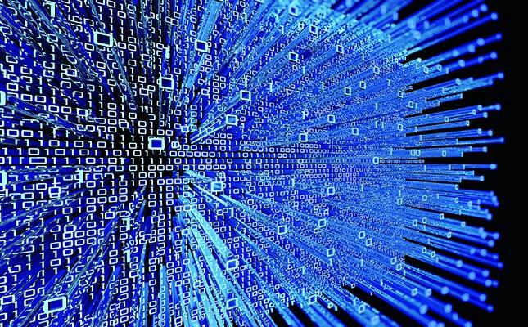
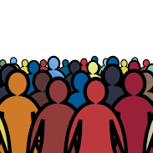
Open Source Community
AI & ML
Internet
Code and algorithms developed that can enhance the normal internet with features designed to increase accessibility.
A global computer network providing a variety of information and communication facilities, consisting of interconnected networks that share the same standards and protocols.
Maintenance
People
Developer community committed to maintaining and improving existing packages, libraries, and modules necessary for clean code
Internet for people of all accessibility levels, centering those most impacted, that are using and creating with open source tools

Slide 13
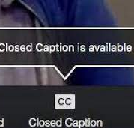
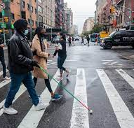
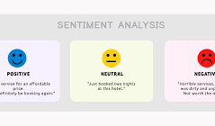
Emerging Technology
VR job interview training for people with autism
AI texting for informal mental health treatment
Understanding empathy in text-based peer support
Improve the accuracy of automatic image descriptions of photos captured by people who are blind or have low vision
Personalized app for pedestrian travel
Improving braille literacy skills via gamification
What else is possible?

Slide 14
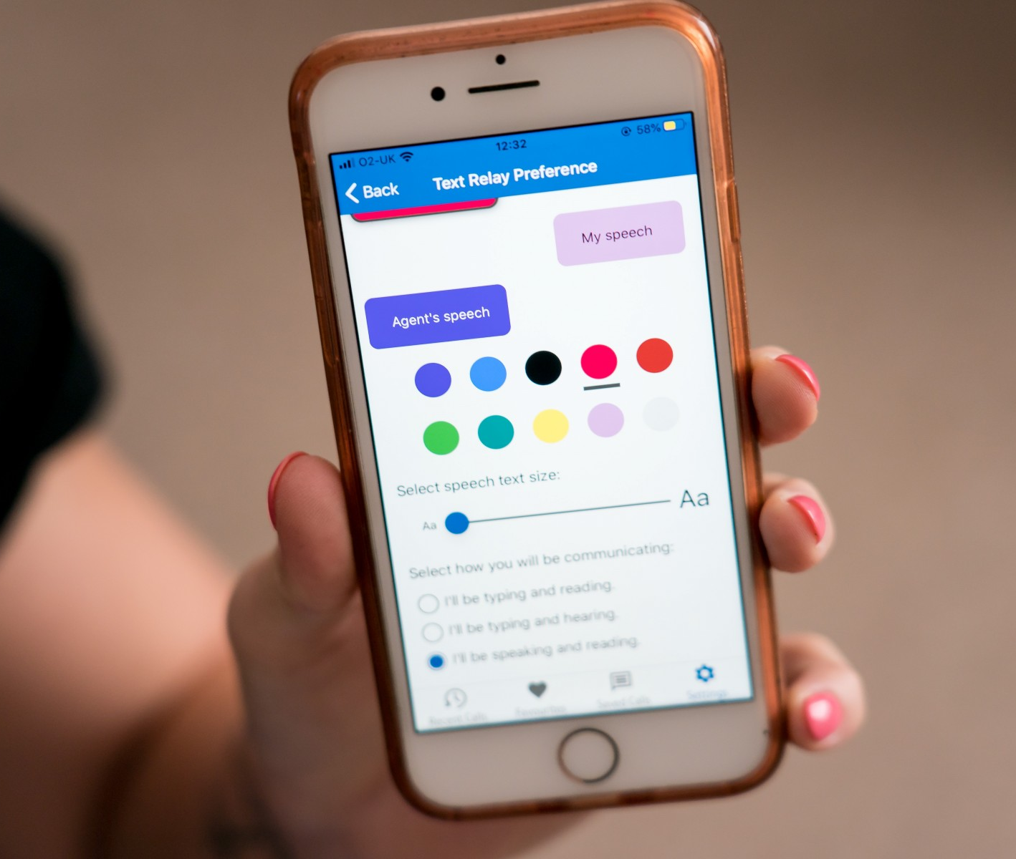
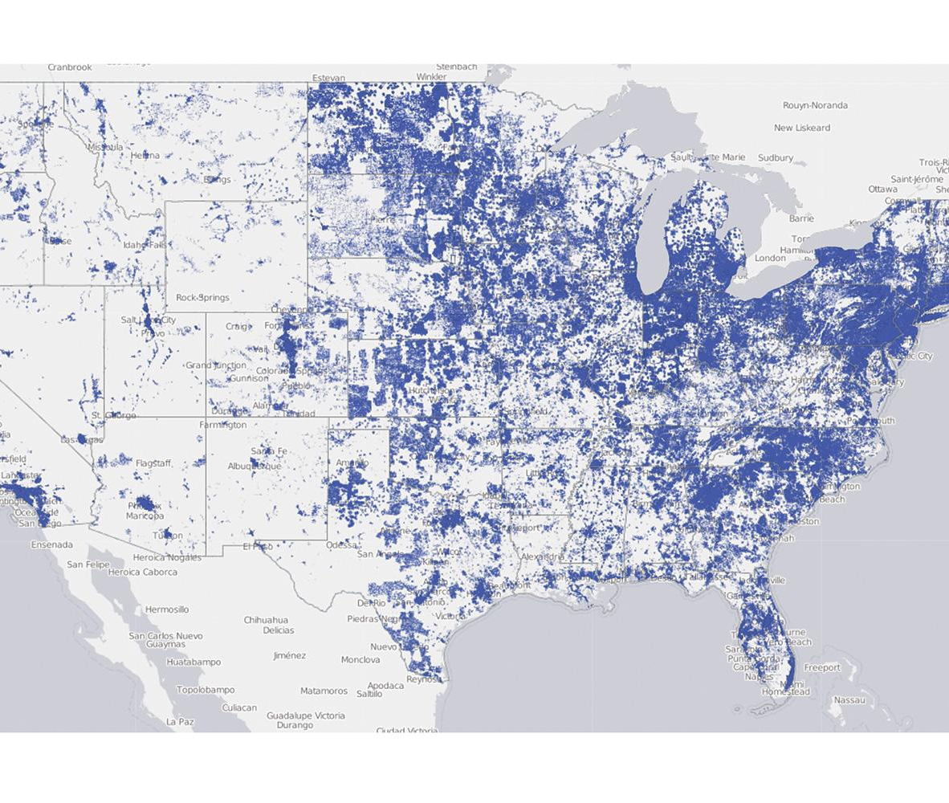
Access and Ability: Tech, Resources, and Information
Vision, Auditory, Speech Disabilities
Places with low broadband
Representative and Unbiased Data
Develop machine learning that provides closed captioning, display larger text size, describe images on a screen, and chat bots that can communicate with people
AI that can reduce some content on a website to allow people in low broadband to still access information.
Providing unbiased and representative data for ML and AI training to have healthier and more robust outputs.
Notes:
Accessibility includes people with low to now access to information and resources.

Slide 15
Accessibility as the Default
Internet
Open Source Community
AI & ML Technologies
The internet with accessibility as the default for people of all ability levels that is safe and secure for people to use
Reduce the barriers to entry for open source communities and networks - Increase accessibility for more diverse and equitable participation in the development and design of technology
Develop machine learning algorithms, CNNs, and ethical AI that are accessible and training on representative and robust data sets to make sense of the patterns in our everyday lives

Slide 16
Prevention
Intervention
Reinvention

Slide 17
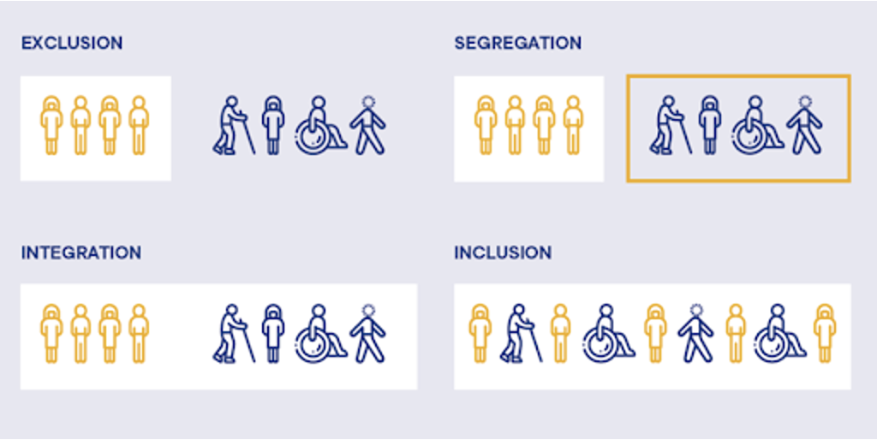
How might we…
How might we prevent and intervene around all forms of exclusion through artificial intelligence and machine learning?
How might we invent / reinvent emerging technologies with accessibility as a forethought and not an afterthought?
How might we best understand contexts as it relates to people with disabilities?
Notes:
integration may remove the boxes, but not designed for people access the space equally. thoughtfully creating space where people have equal access to a space. Inclusion, takes this a step further, where there is equity in a space for people.

Slide 18
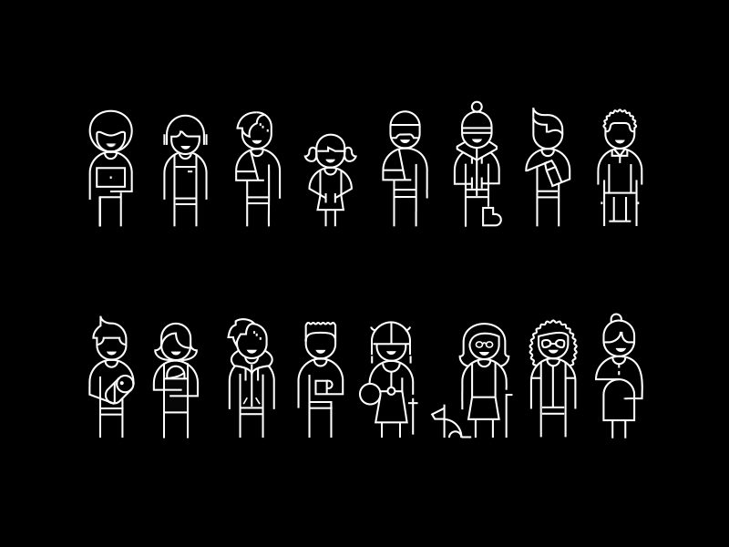
Considerations
Disability is not a one size fits all approach. Throughout a person’s lifetime they may acquire a situational, temporary, and/or permanent disability.
Challenge: AI / ML is programmed to find patterns and form groupings.
Opportunity: Data collection and processing.
Causes of algorithmic bias include historical human biases and incomplete or unrepresentative training data.
Notes:
Algorithmic bias describes systematic and repeatable errors in a computer system that create unfair outcomes, such as privileging one arbitrary group of users over others. Bias can emerge due to many factors, including but not limited to the design of the algorithm or the unintended or unanticipated use or decisions relating to the way data is coded, collected, selected or used to train the algorithm. Unintentional harm is still harm.
Algorithms are harnessing volumes of macro- and micro-data to influence decisions affecting people in a range of tasks, from making movie recommendations to helping banks determine the creditworthiness of individuals.
Hand to Bri for the last bullet

Slide 19
Reinvention
Perceivable
Operable
Understandable
Accessibility
Robust
Notes:
Reinventing AI and ML to contextualize and enhance how we build and think about technology and our theories of change

Slide 20
Reinvention
Context
Ability
Perceivable
Operable
Identity
Understandable
Accessibility
Robust
Habits
Preferences

Slide 21
Reinvention
Context
Ability
Perceivable
Operable
Identity
Understandable
Accessibility
Robust
Habits
Preferences
Beliefs
AI / ML
Desires
Intent

Slide 22
Getting Started
Executive Order 13960: Promoting the Use of Trustworthy Artificial Intelligence in the Federal Government.
AI.Gov & National Artificial Intelligence Act of 2020 coordinated program across the entire Federal government to accelerate AI research and application for the Nation’s economic prosperity and national security.
The Artificial Intelligence R&D Interagency Working Group (AI R&D IWG) was formed in 2018 to coordinate Federal AI R&D across 32 participating agencies and to support activities tasked by both the NSTC Select Committee on AI. The NITRD Subcommittee coordinates AI activities to advance the mission of the National AI Initiative Office (NAIIO).

Slide 23
Getting Started
Call for nominations to serve on the National Artificial Intelligence Advisory Committee in addition to serve on the Subcommittee on Artificial Intelligence and Law Enforcement.
The Artificial Intelligence (AI) Center of Excellence incorporates machine learning, neural networks, intelligent process design and Robotic Process Automation (RPA) to develop AI solutions that address unique business challenges agency-wide.
Artificial Intelligence (AI) Community aims to unite federal employees who are active in, or interested in AI policy, technology, standards, and programs to accelerate the thoughtful adoption of AI across the federal government.
Cloud.gov offers a fast way for federal agencies to host and update websites, APIs, and other applications.

Slide 24
Q&A

