Slide 1
IT Accessibility Community Meeting
Brooke Aiken
FDIC Section 508 Program Manager
Ryan E. Benson
FDIC Deputy Section 508 Program Manager

Slide 2

What is the FDIC?
The Federal Deposit Insurance Corporation (FDIC) is an independent agency created by Congress to maintain stability and public confidence in the nation's financial system.
To accomplish this mission, the FDIC insures deposits; examines and supervises financial institutions for safety, soundness, and consumer protection; makes large and complex financial institutions resolvable; and manages receivership
The FDIC is an independent U.S. agency that protects depositors by insuring their bank accounts, up to $XXXX, per depositor, per insured bank, for each account ownership category
Notes:
Jenny to Launch Poll, Brooke to read poll, answer in poll module, chat or Q&A
Answer: FDIC deposit insurance covers $250,000 per depositor, per FDIC-insured bank, for each account ownership category.

Slide 3
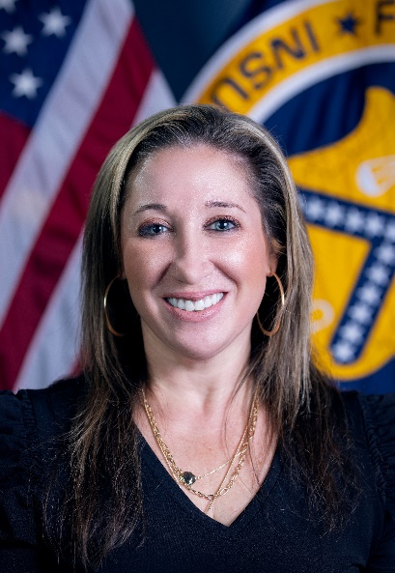

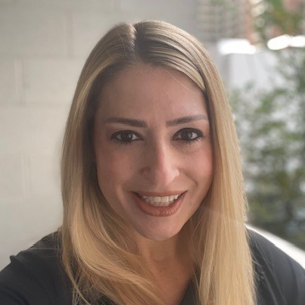


FDIC Section 508 Team
Brooke Aiken
Ryan Benson
Jennifer Meltz
Alfred Vallarta
Danny Guzman

Slide 4

Developing a Section 508 Program at the FDIC
What is important to executives?
Annual Assessment
Documents
Metrics!!
What is important to customers?
Receiving accessible services
What is important in developing a robust program
Keep in mind - FDIC is a unique agency

Slide 5
Section 508 Services at the FDIC
Purchase Requisition Reviews
Outreach/Training
Section 508 Software and Web Application Testing
IT Reasonable Accommodation Services
Section 508 Document Review and Assistance
*New* Governance Stakeholder

Slide 6
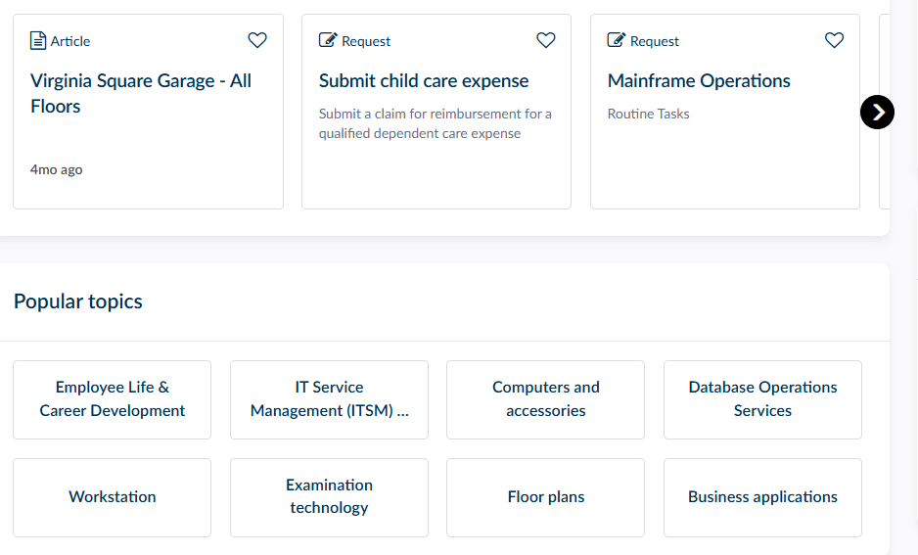
This New Product- Service Now
Supplies a cloud computing platform for the creation and management of automated business workflows.
Came into FDIC existence between 2018/2019
Eliminating service desk emails and phone calls

Slide 7
Preparing the Vision
Timing is crucial – begin conversations early
FDIC utilized the ServiceNow pre-built modules
Cost
508 Team Cost- Contractor Development for:
Requirements
Data Dictionary
Workflow
Initial ServiceNow team - federal employees

Slide 8
Requirements
All roles within your 508 team are essential for requirements
Ask questions
What do you want the page to look like?
Can you customize your landing page?
What services will you provide to your agency?
ICT Application Test Requests
VPAT/ACR Reviews
Document Reviews
Exception Requests
IT Reasonable Accommodations
Training Requests

Slide 9
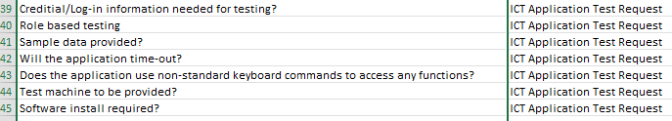
Data Dictionary
Foundation for your ServiceNow modules
What questions will you ask within your modules?
What is the information you need from your customers?

Slide 10
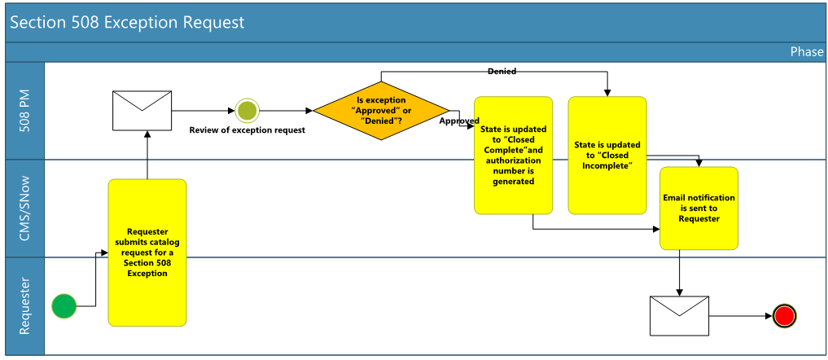
Workflows

Slide 11
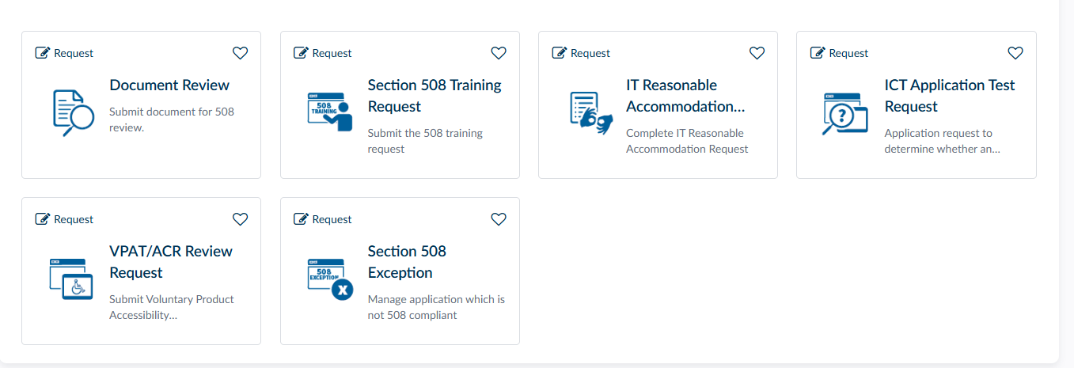
“If You Build It… They Will Come”

Slide 12
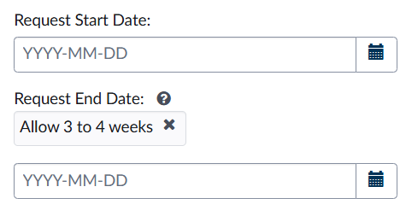
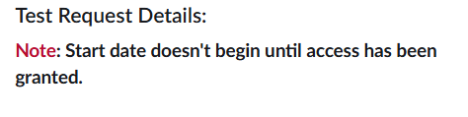
Ticket Management and Expectations
ONE team member manages the distribution of the ServiceNow tickets
Set clear expectations for turn around time
Understand the transition for customers will take time to acclimate
Examples of expectations within ServiceNow modules

Slide 13
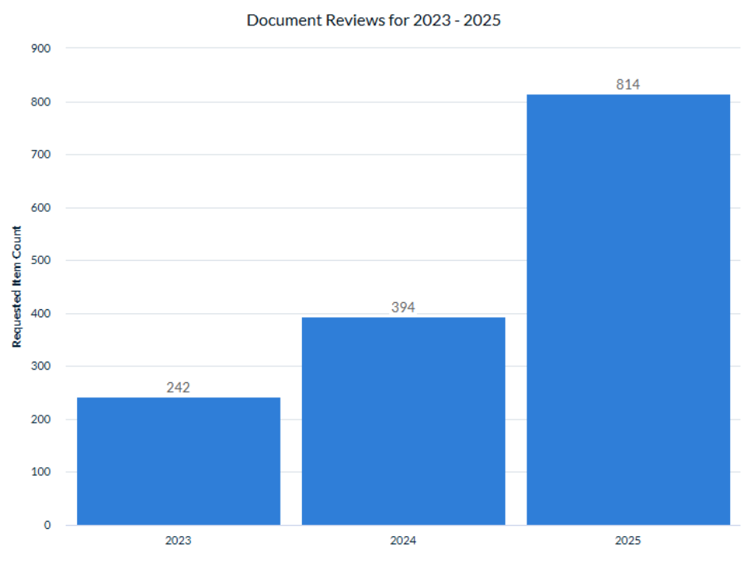
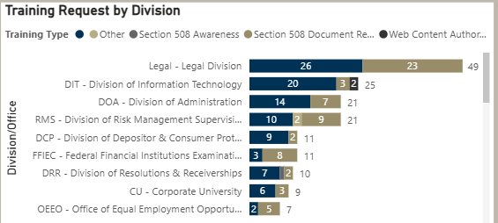
Reporting and Executive Feedback
Executives love metrics
Executives love charts
Executives love the bottom line

Slide 14
How to Request a 508 Service
FDIC Section 508 Intranet Site – The FDIC’s internal site for information and resources on Section 508 compliancy.
Section 508 Service Now Portal - Any Section 508 Service requests (Application Test Requests, Document Reviews, Trainings, etc..) can be made here.
Section508@fdic.gov – Use this email address to reach out to the entire team for any questions about Section 508.

Slide 15

Takeaways and Lessons Learned
Utilize what is available within your agency
Learn and value what is important to your management
Establish relationships
Communicate what will enhance your 508 program
“If You Build It, They Will Come”

Slide 16

Questions & Contact Information
Brooke Aiken
Braiken@FDIC.gov
Ryan Benson
Rybenson@fdic.gov
Section 508 Team Mailbox
Section508@fdic.gov

