Slide 1


Voice AI for Everyone: Ensuring Usability and Access in Digital Environments
Hope Gerlach-Houck, Caryn Herring, J. Scott Yaruss, Ann Marie Ryan, Nihar Mahapatra
May 20-21, 2025

Slide 2
























Voice AI is Ubiquitous
Voice AI is increasingly central to our daily lives, as billions of devices rely on ever more ubiquitous voice interfaces, including at home, at work, on the road, in the doctor’s office, and more.
Applications
Devices

Slide 3
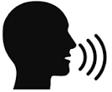



Voice AI and ASR
Voice AI applications rely on a core AI technology called automatic speech recognition (ASR).
ASRs convert spoken language into text, enabling voice AI to facilitate a variety of tasks.
Existing ASRs are typically trained on mainstream speech.
ASR
Speech
Transcript
Tasks

Slide 4






Voice AI: Helpful for Many, Obstacle for Others
While many find them helpful, for millions who speak differently, voice AI applications relying on such ASRs can be extremely limiting.
Leading ASR systems, including Google Cloud and OpenAI, exhibit more than double the word error rates for speakers who stutter compared to those who do not. (Mujtaba et al., 2024).
The errors made by leading ASRs are more semantically incorrect for stuttered speech, which can have serious personal and professional consequences
  Wav2Vec2.0

Slide 5




Semantic Accuracy is Critical: Example 1 (Slide 1)
Tell me about a time when you had to act quickly?

Slide 6

Semantic Accuracy is Critical: Example 1 (Slide 2)
Tell me about a time when you had to act quickly?
I
Can
usually
assassin sis?
To hit you.
What
will we will
go away. Shannon,
problem-solve
as I go.
and then

Slide 7
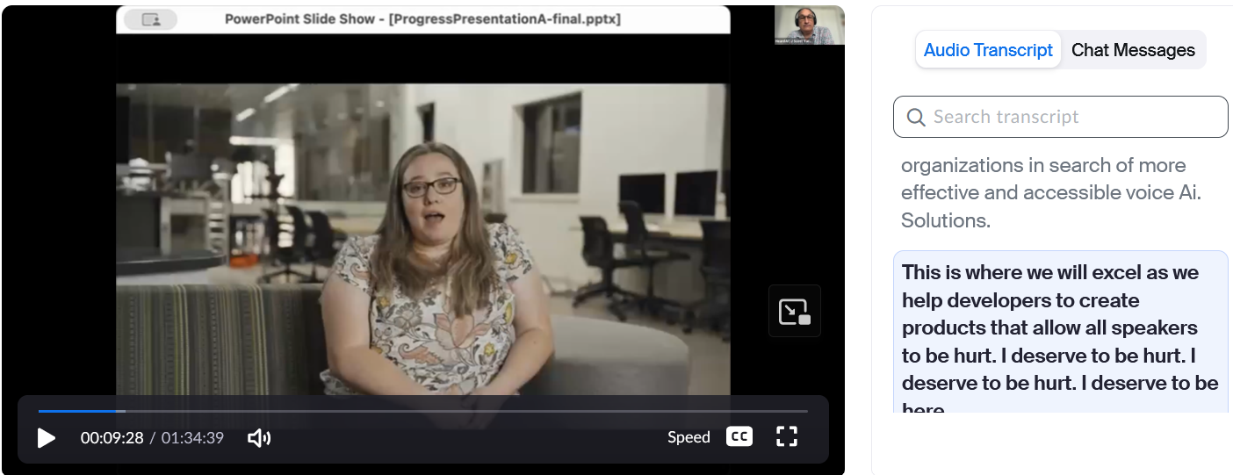
Semantic Accuracy is Critical: Example 2

Slide 8
Voice AI: Helpful for Many, Barrier for Others
Accessibility barriers in voice AI extend far beyond word and semantic error rates, and include…
  Activation failures
  Interruptions
  Misunderstanding
  Usability issues
  Embarrassing risks
  Task failures
  Harmful outcomes
Making voice AI accessible requires intimate understanding of the nature of speaking differences and their intersections with the subtle but critical design choices in technology

Slide 9
About HeardAI
At HeardAI, our mission is to transform voice AI by…
  Designing it to work well for everyone
  Evaluating it with many different communicators, and
  Offering guidelines to promote successful adoption and use
We have been collecting speech samples from diverse communicators, starting with speakers who stutter, to inform development of an ASR that accurately decodes all human speech
Some key differentiators of our project:
  Deep engagement with end-user communities
  Personalization that is meaningful and specific to the needs of diverse speakers

Slide 10
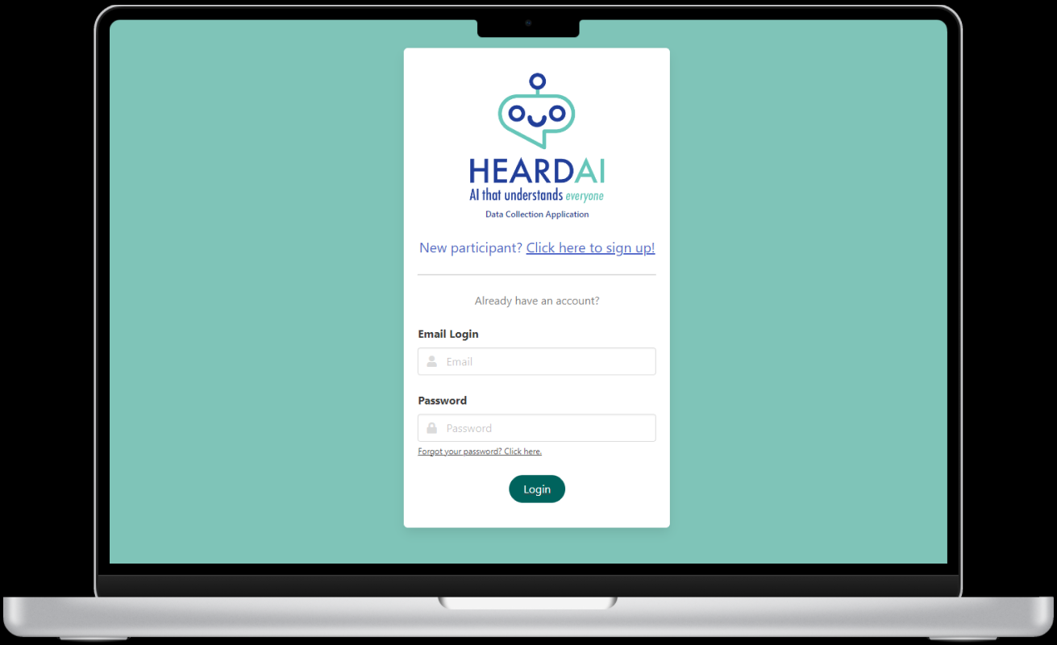

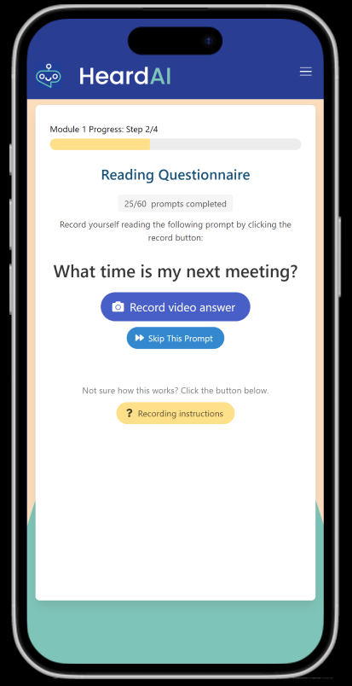
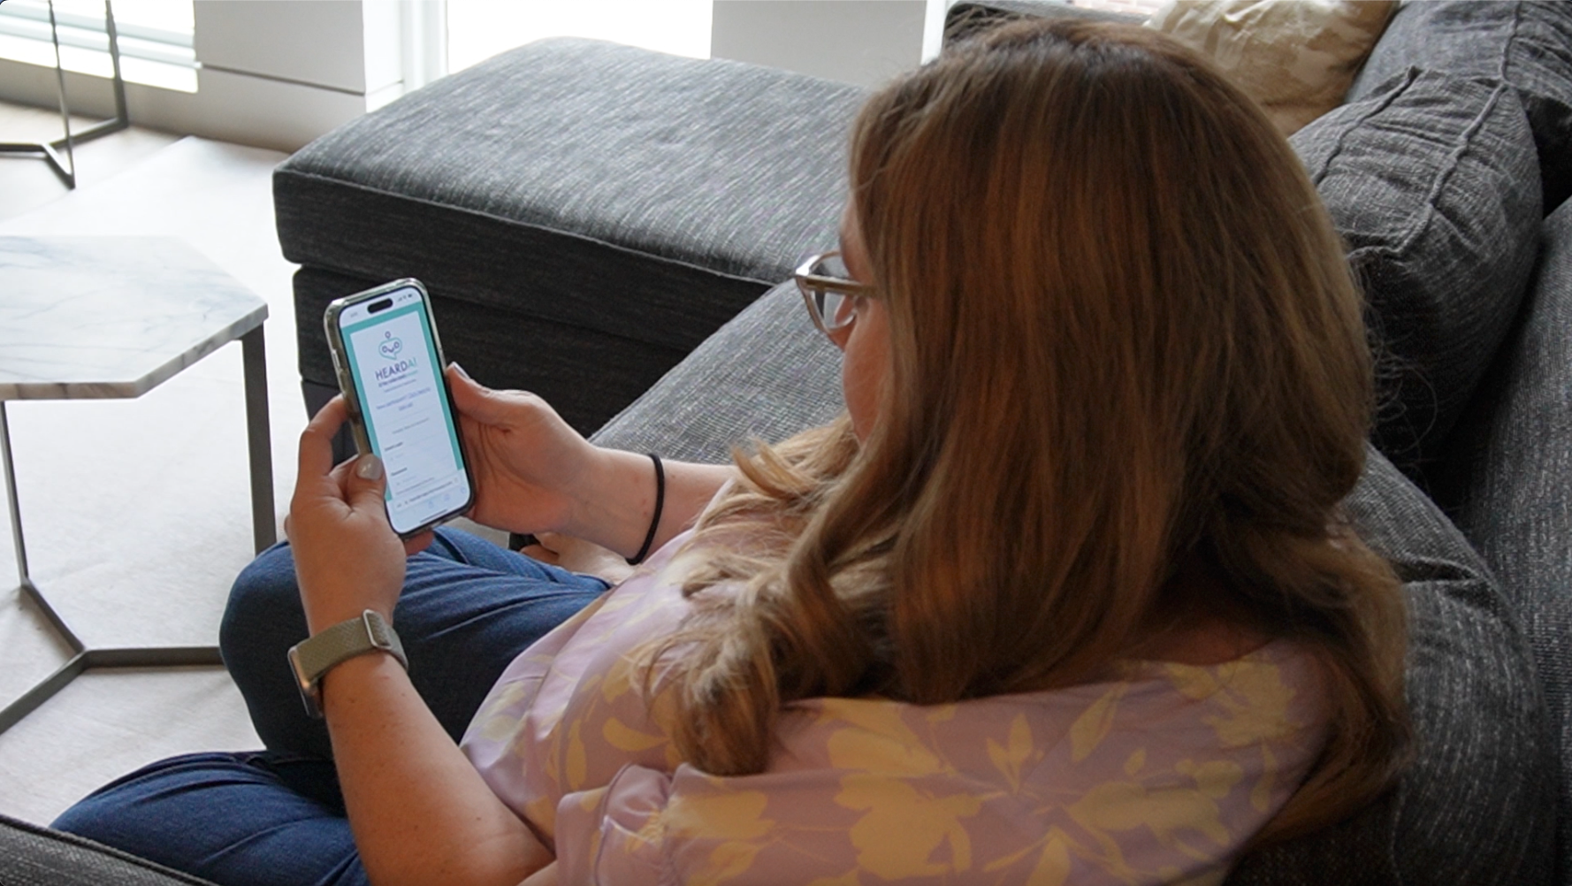
Our Data Collection App
Our Heard AI data collection app is available on desktop and mobile devices
To date, we have received 6396 completed prompts from 230 speakers
Desktop
Mobile

Slide 11
Data Collection: Scripted Utterances
Each participant speaks 60 scripted utterances from 20 diverse real-world application contexts, while recording audio and video

Slide 12
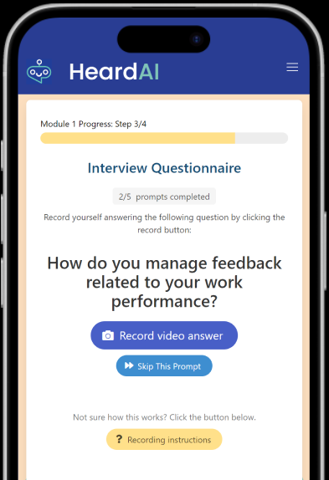
Data Collection: Unscripted Utterances
We also collect unscripted, spontaneous speech samples
Participants respond to 5 randomly selected questions from a bank of 50 interview-style prompts

Slide 13
HeardAI v0.2 ASR Evaluation (Slide 1)
Compared to leading market ASRs, early evaluation indicates significant reduction in both word and semantic error rates with the Heard AI ASR (Mujtaba et al., 2024)
Example transcription:
  INTENDED UTTERANCE: Call the nearest pharmacy
  MARKET ASR: Call the Nini. Nini. It's Farfaw. Arfaw. Armacy.
  HeardAI ASR: Call the nearest pharmacy.
ASR | Word error rate | Semantic error rate
Baseline ASR | 46.58 | 43.91
HeardAI v0.1 | 24.44 | 29.60
HeardAI v0.2 | 15.06 | 20.31

Slide 14
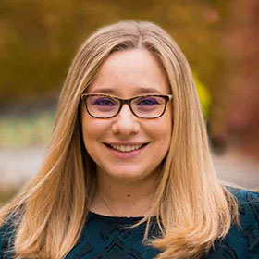
HeardAI v0.2 ASR Evaluation (Slide 2)
Tell me about a time when you had to act quickly?
Tell me about a time when you had to act quickly?
HeardAI ASR v0.2
I Can usually assassin sis? To hit you. What will we will go away. Shannon, and then problem-solve as I go.
I can usually assess the situation and then problem solve as I go.

Slide 15
Voice AI for All: Moving Forward
Technology can both reduce and create obstacles
Designing usable technology means anticipating diverse communicators
AI has the potential to include everyone
Steps you can take:
  Effective communication (e.g., don’t interrupt or fill in when someone stutters)
  Support and adopt tools that are functional for everyone
  Share HeardAI's resources

Slide 16
HEARD AI
heardai.ai

