Slide 1

Advancing Accessibility and Engagement on Social Media
May 21, 2026

Slide 2
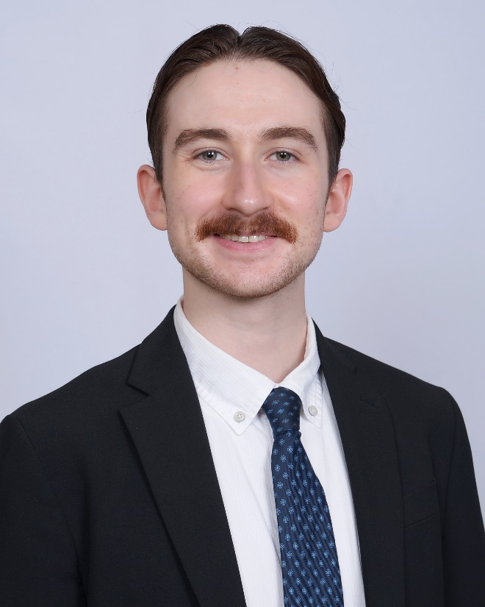
Presenter
David O’Keefe
Communications Specialist
U.S. Access Board

Slide 3
Agenda
Introduction to U.S. Access Board
Key features of social media accessibility
Social media engagement strategies
Resources
Q&A

Slide 4
Introduction to U.S. Access Board

Slide 5
What is the Access Board?
Independent federal agency dedicated to accessible design for people with disabilities
Develops minimum accessibility guidelines and standards under several federal laws, such as:
  Americans with Disabilities Act (ADA)
  Architectural Barriers Act (ABA)
  Section 508 of the Rehabilitation Act
Enforces accessibility standards issued under the ABA, which apply to federal buildings and facilities

Slide 6
What Can the Access Board Do for You?
Provides free, confidential technical assistance on its guidelines and standards through its helpline and email:
  1-202-272-0080, extension 3
  ta@access-board.gov
Investigates ABA complaints submitted by the public
Conducts monthly webinars on topics related to the accessibility of the built environment and information and communication technology (ICT)
Hosts town halls and other events to engage with the public and learn about the state of accessibility around the nation

Slide 7
Key Features of Social Media Accessibility

Slide 8
Alt Text (1)
Alt text (short for alternative text) is text that is embedded into images or GIFs that conveys the meaning of the image
Alt text is designed to make visual content accessible to people who are using screen readers
In general, alt text should be concise, communicate relevant content provided by the image, and not repeat any information provided in the text of the post

Slide 9
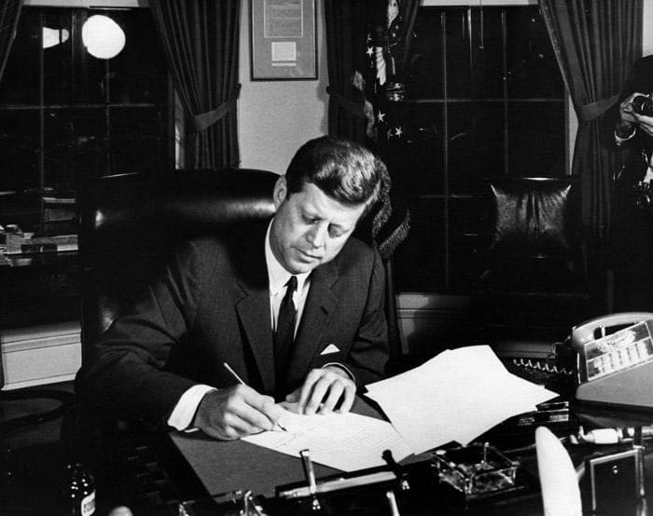
Alt Text (2)
Example of alt text for photos:
  Helpful: “President Kennedy signs a bill in the Oval Office.”
  Unhelpful: “Black and white photo of President Kennedy wearing a suit. He is signing a bill in the Oval Office with the curtains open behind him.”

Slide 10

Alt Text (3)
Example of alt text for images that contain text:
  Helpful: “Fair Housing Accessibility First logo with tagline: fair housing instruction, resources, support, technical guidance.”
  Unhelpful: “FHAF logo.”

Slide 11
Color Contrast (1)
Color contrast is the difference between the color of text and the color of the background behind it
Certain color contrast ratios can result in the text of a graphic or image being difficult to read
Excluding logos or brand names, it is best to maintain a contrast ratio of 4.5:1 for regular text and 3:1 for large text
  This ratio is the minimum required for federal content creators
Use a color contrast analyzer to determine the ratio of your graphic
  There are various free versions of this tool available online

Slide 12
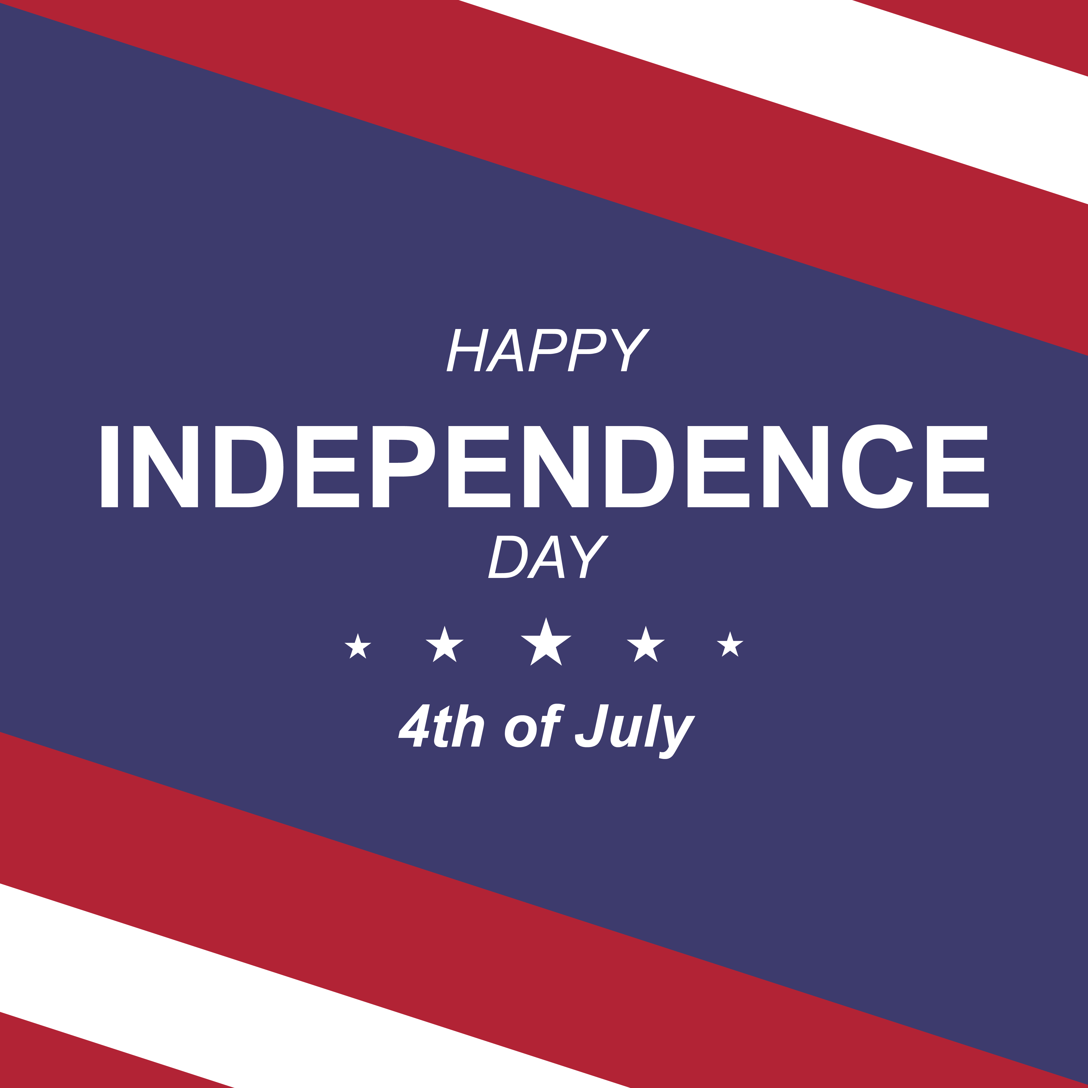
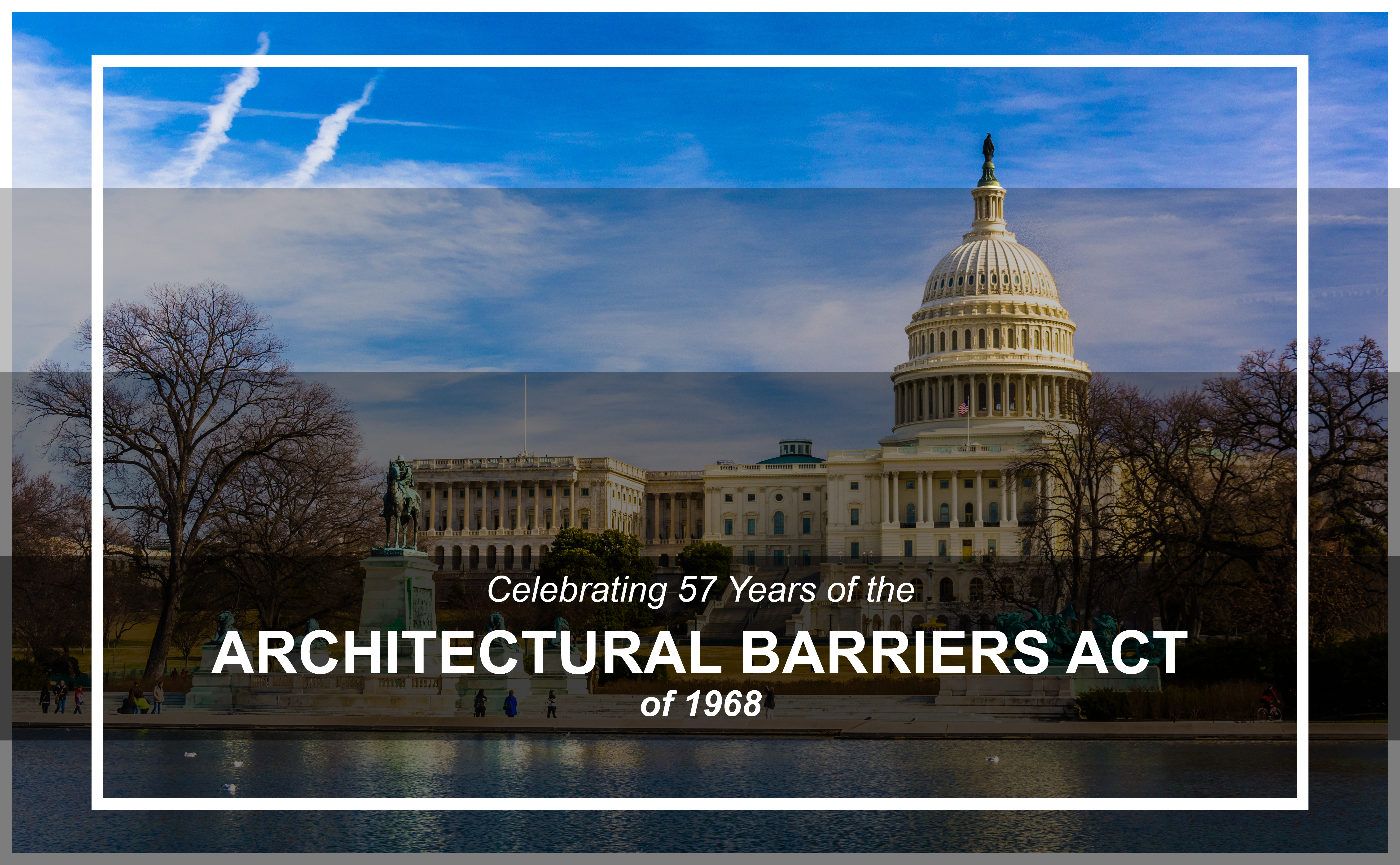
Color Contrast (2)
Examples of graphics with accessible color contrast:

Slide 13
Emojis (1)
Too many emojis in one post can be confusing or annoying for users of screen readers, as these programs will individually describe each emoji
  Using several emojis in a row can cause the same problem
Placing emojis in between sentences in the text of a post can be disorienting and distracting as well
  It is best to place emojis at natural stopping points in the text of a post, such as at the end of a paragraph or prior to a link that concludes a post

Slide 14
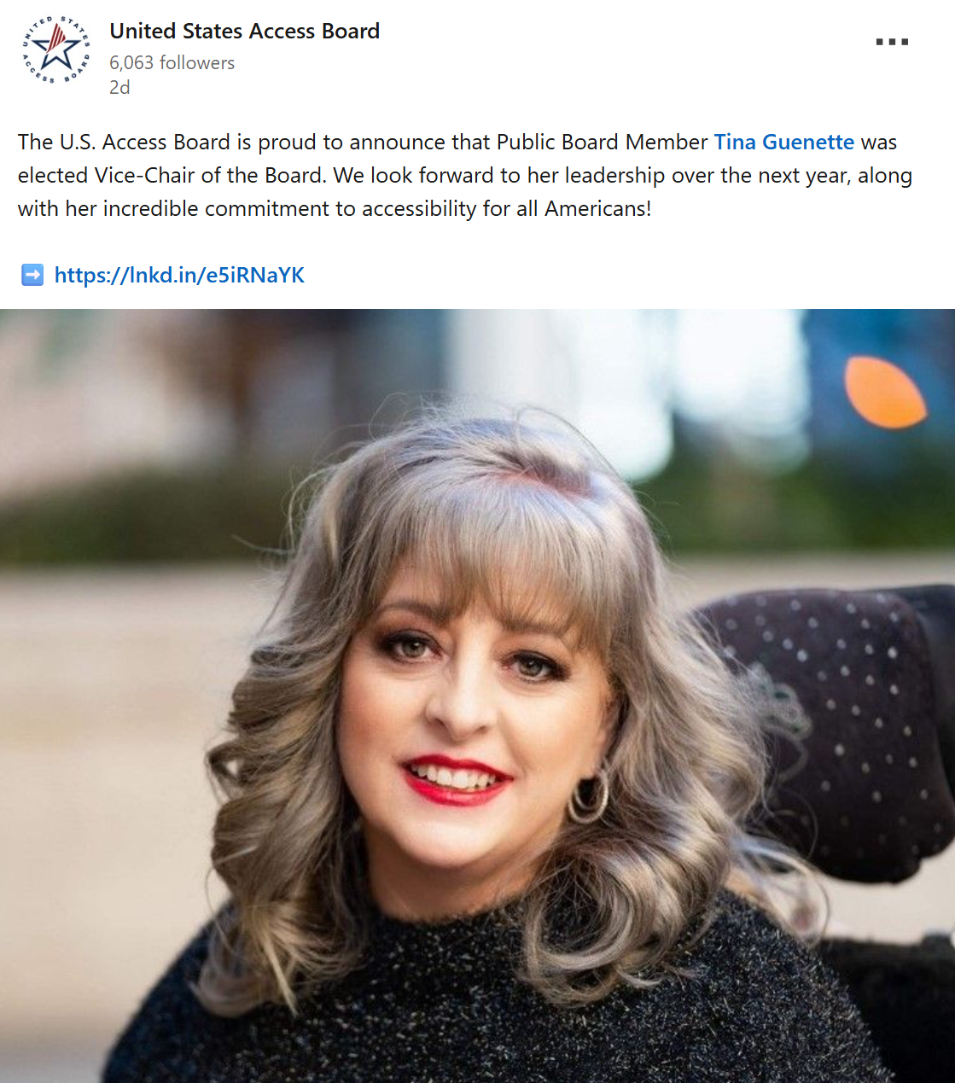
Emojis (2)
Example:

Slide 15
GIFs
Since GIFs don’t usually have user controls to pause, stop, or hide the animation, and may include harmful flashing or blinking, it is not recommended to use GIFs unless they can be made fully accessible
  Some social media sites may incorporate these controls, but this must be considered on a platform-by-platform basis
If you do use GIFs, and they contain text, then ensure that they have an accessible color contrast
  Always include alt text for GIFs

Slide 16
Hashtags
Screen readers may see a multi-word hashtag as being one word, and they will read it as such
  Therefore, always capitalize each word in a multi-word hashtag
  If possible, do the same with your account handles
Examples:
  #MemorialDay
  #America250
  @AccessBoard
  @USPS

Slide 17
Plain Language (1)
Plain language is writing that is designed to be understood as quickly and clearly as possible
It is best to use plain language when creating public-facing content for social media
Important elements of plain language include:
  Use of active voice
  Short sentences
  Step-by-step instructions
  Avoiding complicated terminology

Slide 18
Plain Language (2)
Example of confusing text:
  Medicaid: Apply if you are aged (65 years old or older), blind, or have a disability and have low income and few resources. Apply if you are terminally ill and want to receive hospice services. Apply if you are aged, blind, or have a disability; live in a nursing home; and have low income and limited resources. Apply if you are aged, blind, or have a disability and need nursing home care, but can stay at home with special community care services. Apply if you are eligible for Medicare and have low income and limited resources.

Slide 19
Plain Language (3)
Example of effective plain language:
  You may apply for Medicaid if you are:
    Terminally ill and want hospice services
    Eligible for Medicare and have low income and limited resources
    65 years old or older, blind, or have a disability, and have low income, few resources, and:
      Live in a nursing home
      Need nursing home care but can stay at home with special community care services

Slide 20


Special Characters
Special characters are letters or symbols that don’t appear on the QWERTY keyboard
Screen readers may struggle to properly identify special characters, so it is best to avoid using them in social media posts
Examples:
Paragraph sign (pilcrow)
Slashed O

Slide 21
Social Media Engagement Strategies

Slide 22
Choosing the Right Platforms (1)
At any given time, there are over a dozen social media platforms being used by large portions of the public
Don’t try to corner the market by joining every platform possible, instead:
  Identify what your agency’s capabilities are
  Review your current social media accounts
  Join new platforms to cover your bases
  Pull back on platforms that are redundant or unable to be maintained

Slide 23
Choosing the Right Platforms (2)
Short-form video content is currently one of the major trends on social media
  Nevertheless, don’t limit yourself by appealing only to a single medium or trend
Consider joining 3-4 platforms across different focus areas:
  Discussion-focused: X, Threads, Bluesky
  Events and text-oriented content: Facebook, LinkedIn, Reddit
  Images and short-form content: Instagram, Pinterest, Snapchat
  Long-form content: YouTube

Slide 24
Choosing the Right Platforms (3)
Aim to use enough platforms to support different types of content, but avoid joining so many that quality is sacrificed
The Access Board is active on four platforms, and posts daily on three platforms:
  X (daily)
  LinkedIn (daily)
  Facebook (daily)
  YouTube (irregular intervals)

Slide 25
Crafting Your Content
Before creating content for any platform, decide on:
  Purpose: Why are you making this post?
  Audience: Who are you making this post for?
  Content: What are you going to post, and in what medium?
Try to play to the strengths of each platform, for example:
  X: Brief text (280 characters), images, short-form video
  LinkedIn: Long text, images, short-form video, events, livestreams, professional setting
  Facebook: Long text, images, short-form video, events, livestreams, casual setting, cross-platform integration (Instagram and Threads)

Slide 26
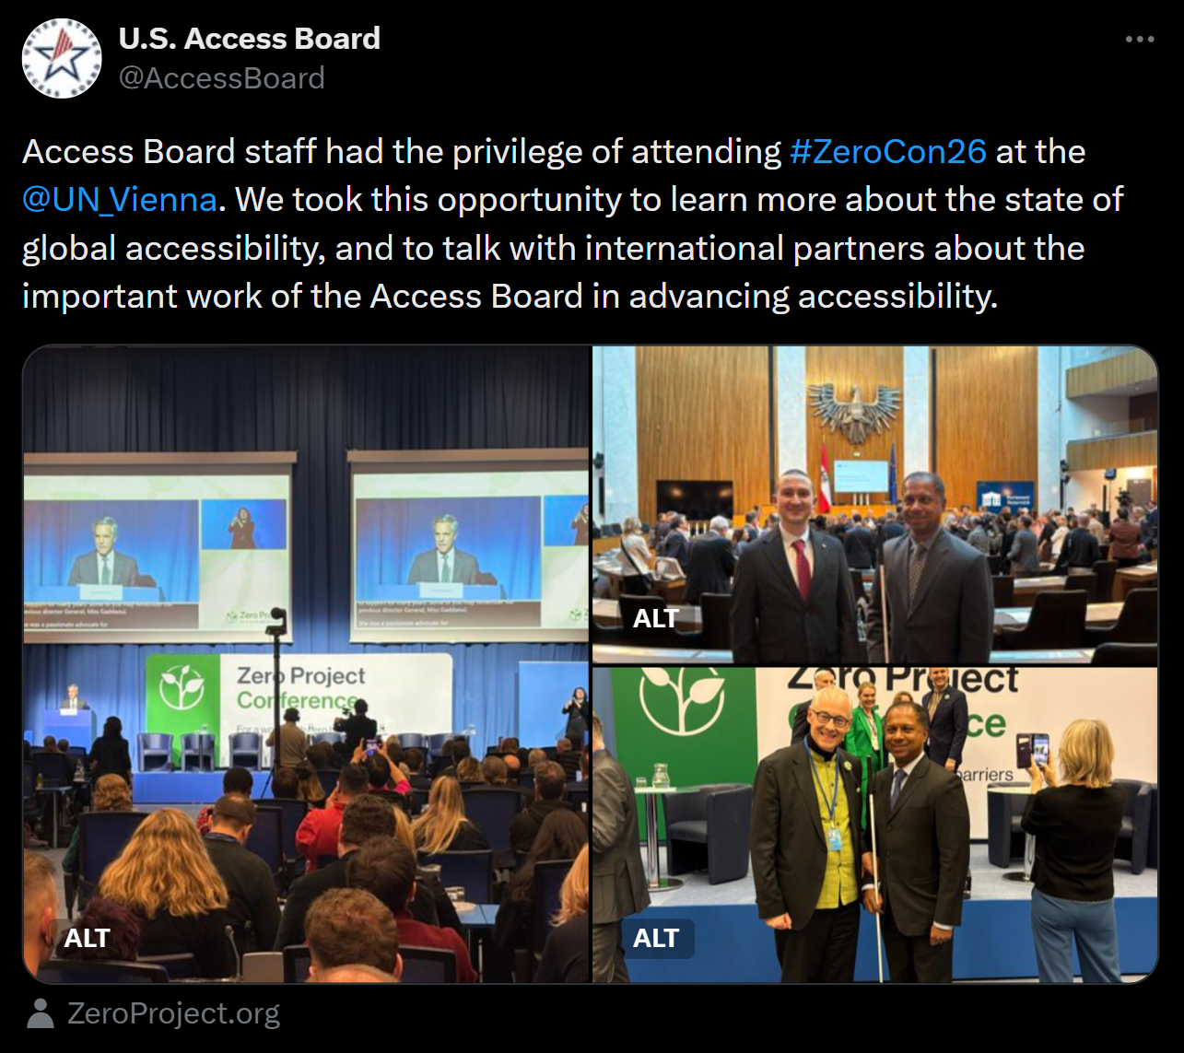
X Example Post

Slide 27
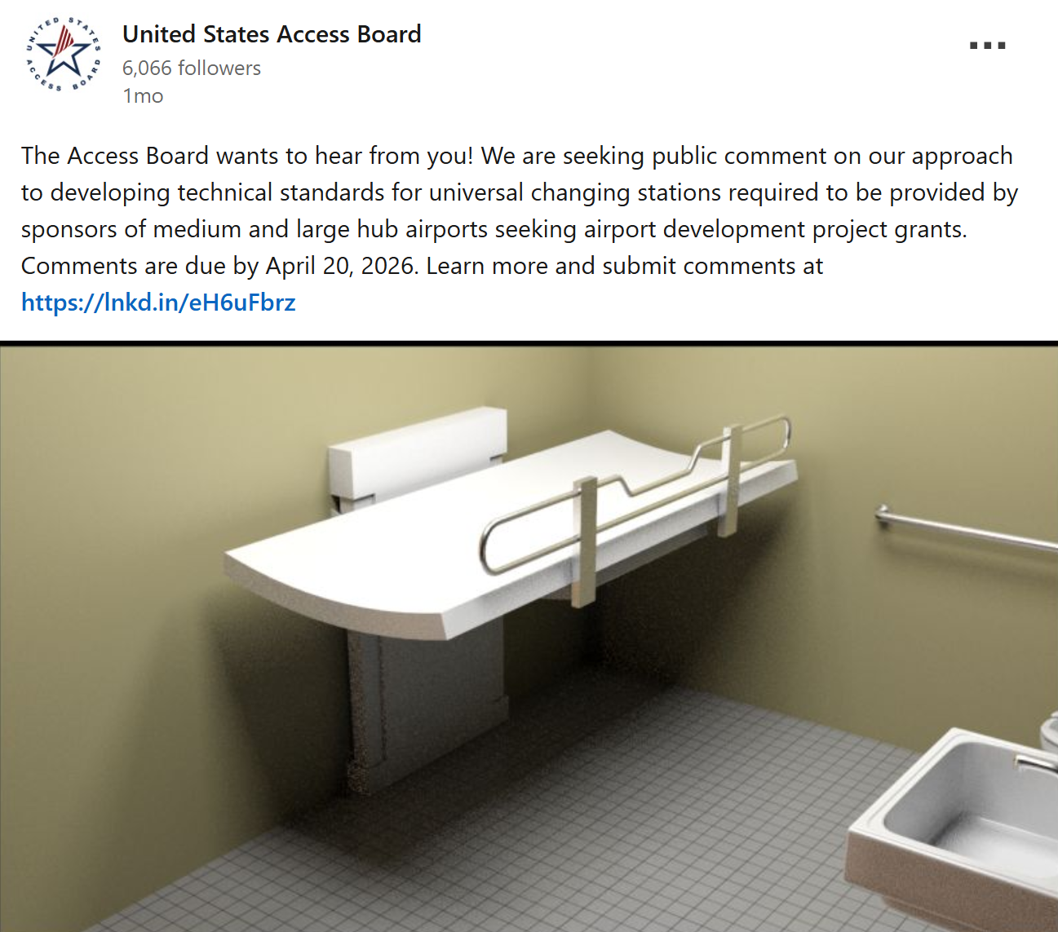
LinkedIn Example Post

Slide 28
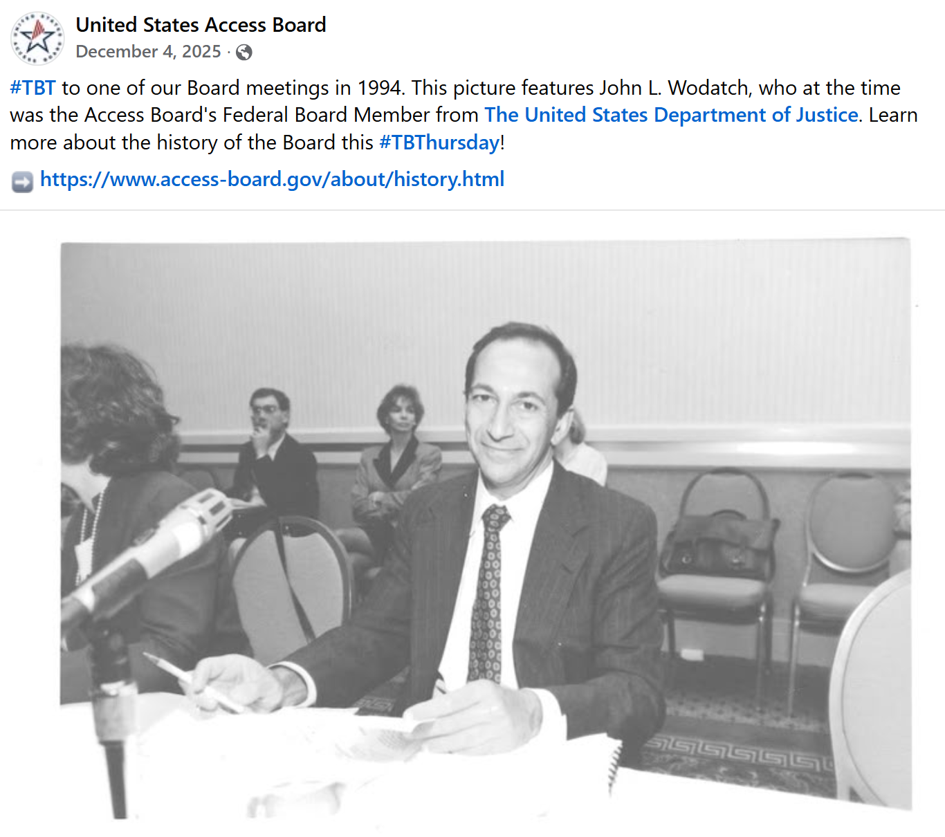
Facebook Example Post

Slide 29
Resources

Slide 30

Access Board Social Media
View examples of accessible social media content from the Access Board on:
  X: @AccessBoard
  LinkedIn: @us-access-board
  Facebook: @usAccessBoard
  YouTube: U.S. Access Board

Slide 31
Federal Resources
Section508.gov provides guidance on accessible social media content creation
Digital.gov houses resources on various topics, including:
  Digital accessibility
  Social media
  Multimedia
  Plain language
The Access Board hosts bi-monthly webinars on topics related to the accessibility of ICT

Slide 32
Platform Resources
X
LinkedIn
Facebook
YouTube
Instagram
Snapchat
Pinterest
Reddit

Slide 33
Q&A

Slide 34
Thank You

