Slide 1

Managing Change, Sustaining Accessibility
Antonio Haileselassie
The National Institutes of Health
May 21, 2026

Slide 2
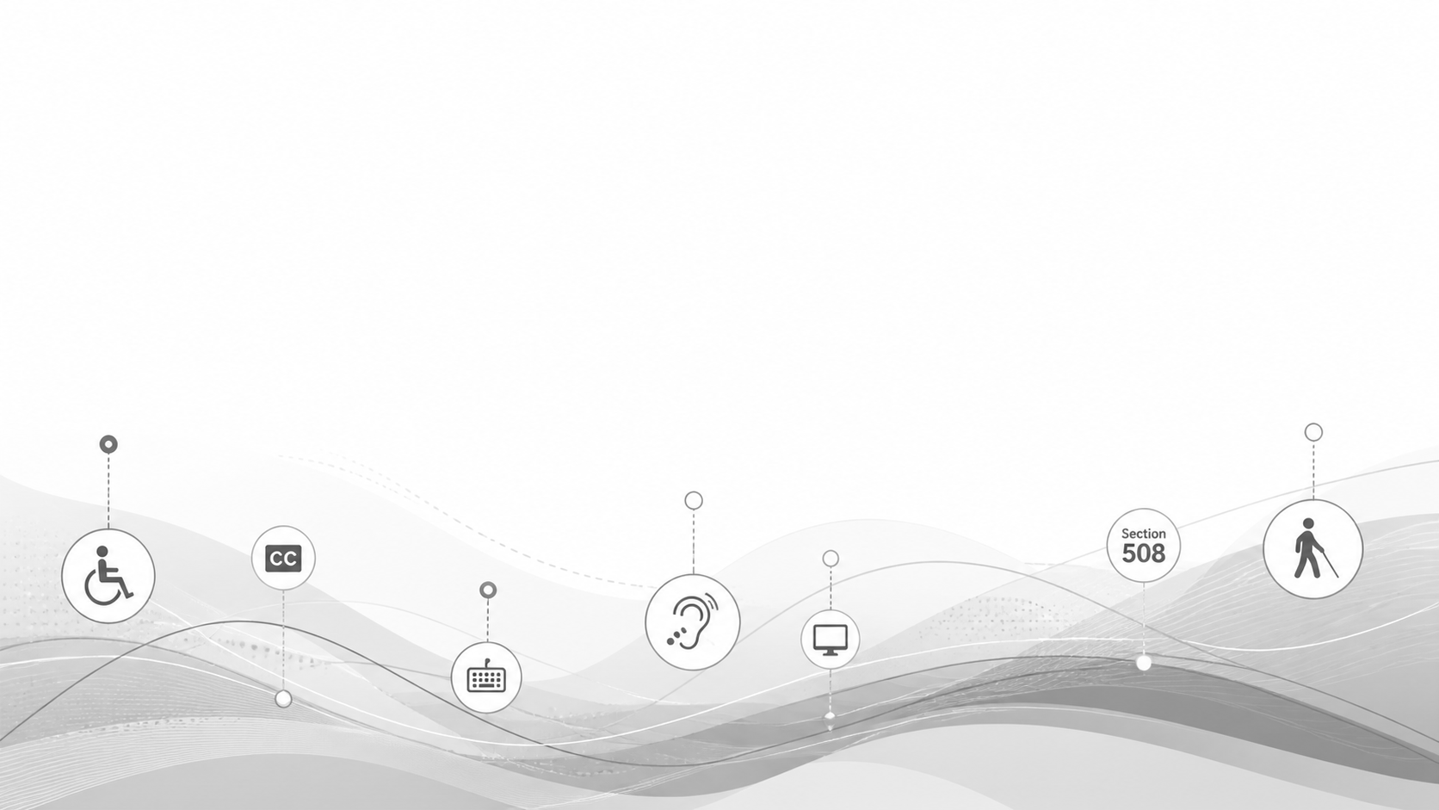
Section 508 in a minute
If everyone is enabled, then no one is disabled
Required
Practical
Human
Section 508 requires federal agencies to make ICT they develop, procure, maintain, or use accessible to employees and members of the public with disabilities.
It applies to the digital work people touch every day: websites, documents, software, applications, official communications, and acquired technology.
Accessibility connects government ICT with assistive technology and makes services work for people with different abilities, contexts, and needs.
Interagency Accessibility Forum | Managing Change, Sustaining Accessibility | The National Institutes of Health
2
Notes:
Keep the Section 508 overview brief. This audience already understands the law, so use this slide to set the framing. Section 508 is not only a compliance issue. It is a workflow issue. The challenge is getting accessibility into the everyday points where decisions are made.

Slide 3
Change Management and Section 508
Change management is how organizations plan for and adapt to change.
Section 508 programs must be resilient because the environment keeps moving
Manage change in a way that keeps accessibility from dropping out of the process.
New program manager
New program or mission priority
Contract changes or new contractors
Reduction in force or staffing gaps
Resignations and retirements
Centralization or reorganization
Change does not have to be a setback; it can be an opportunity to improve.
Interagency Accessibility Forum | Managing Change, Sustaining Accessibility | The National Institutes of Health
3
Notes:
Use this slide to normalize change. Change can be leadership turnover, contract turnover, staffing shortages, retirements, a new program, new technology, or centralization. If accessibility depends on a few individuals or informal relationships, every change becomes a risk. A mature program builds practices, roles, templates, and governance that can survive those changes.

Slide 4
Challenges of Change
Without clear ownership, role clarity, and knowledge, change can weaken accessibility .
Creates Risk
Creates Accessibility Debt
Staff or contractor turnover can take accessibility knowledge with it
New personnel may not understand roles, requirements, or expectations
Changes can blur ownership, review points, and decision-making
If accessibility depends on a few people, execution becomes fragile when those people leave
Accessibility can drop out of planning, design, procurement, or review
Inconsistent execution can create repeated mistakes and new barriers
Rework, delay, and accessibility debt can grow quickly
The longer change goes without accessibility, the harder and more expensive the recovery becomes
Interagency Accessibility Forum | Managing Change, Sustaining Accessibility | The National Institutes of Health
4

Slide 5
Use the Technology Accessibility Playbook
The Technology Accessibility Playbook provides structure and consistency
1. Foundations
2. Integration
3. Improvement
Leadership commitment
Current maturity
Goals and metrics
Policy and accountability
Program team
Budget considerations
Enterprise function
Requirements and design processes
Acquisition processes
Development processes
Testing and validation
Issue resolution
Training and skills
For change management with Section 508, the key move is translating the plays into roles, gates, tools, and habits for your organization.
Interagency Accessibility Forum | Managing Change, Sustaining Accessibility | The National Institutes of Health
5
Notes:
The playbook is useful because it gives program managers a structured vocabulary. It is not only guidance. It is a way to have change-management conversations with leadership and stakeholders: What is our maturity? What are our goals? Where does accessibility fit into governance, design, acquisition, development, testing, and training?

Slide 6
When Change happens, Assess the program and the gaps
The true current state determines the right change strategy
Current State
Change Triggers
Gaps and Risks
Roadmap
What is happening today?
Where does review happen?
Who decides?
What does ‘maturity’ look like?
What changed:
people, contracts, funding, systems, governance?
Where are responsibilities unclear?
Where is expertise inconsistent?
What changes first, next, and later?
How do we build buy-in?
Assessing change does not slow progress.
It speeds it up by avoiding solving the wrong problem.
Interagency Accessibility Forum | Managing Change, Sustaining Accessibility | The National Institutes of Health
6
Notes:
This slide maps directly to change management. Before changing a program, assess the current state. Look at program maturity, stakeholder readiness, current review points, contract realities, staffing, tools, and pain points. This is also the point to assess whether goals still make sense after a major change.

Slide 7
Navigate change with a Roadmap
A roadmap helps break down change into manageable phases
Phase 1
Phase 2
Phase 3
Phase 4
Phase 5
Awareness
Support
ICT Acquisitions
Official Guidance
Monitoring
Build recognition and early buy-in
Make resources, help and training easy to find, use, and deliver.
Build requirements into buying decisions
Clarify roles, responsibilities, and process
Measure, review, report, and improve
Example adapted from NIH roadmap framing used in prior Section 508 program updates.
Awareness first seems counter-intuitive but can be beneficial.
It creates the permission structure for later governance, training, and monitoring.
Interagency Accessibility Forum | Managing Change, Sustaining Accessibility | The National Institutes of Health
7
Notes:
Use this slide to tell the NIH roadmap story. The phases are not just tasks. They are a change-management sequence. Awareness was placed early on purpose: it helps supervisors, administrators, and program owners understand why accessibility matters before asking them to change behavior. Then support, acquisition, guidance, and monitoring can build on that buy-in.

Slide 8
Everyone is Responsible
The program enables the work, but owners and creators must build it in
Fragile Model
Resilient Model
508 team as last stop/gate
Contractor self-review or no review
Late testing and emergency remediation
Knowledge held by a few people
Content creators and IT owners understand their role
508 support embedded in planning and design
Testing validates, not discovers, the basics
Program knowledge is documented and repeatable
Interagency Accessibility Forum | Managing Change, Sustaining Accessibility | The National Institutes of Health
8
Notes:
This is the culture slide. The 508 program cannot be the only place where accessibility lives. Content creators and IT owners have to understand what they are responsible for. The program provides guidance, training, standards, tools, and review. But the work has to be owned where the content, applications, and services are created and managed.

Slide 9
The Old Way: Accessibility at the End
Late review turns a preventable issue into a change-management problem
Requirement Phase
Idea
Design
Build
Launch Review
Remediate
When accessibility shows up late,
the work changes shape:
Move away from
“Remediation” mentality.
Costly rework
Delayed delivery
Overly complex applications
Avoidable compliance exposure
Barriers for employees, patients, research communities, and the public
Interagency Accessibility Forum | Managing Change, Sustaining Accessibility | The National Institutes of Health
9
Notes:
Tell the late-review story. In many organizations, accessibility is still treated as a final review step. That creates frustration for everyone: the 508 office, developers, content owners, contracting teams, and users. The objective is not to make every person an accessibility expert. The objective is to make accessibility part of the expected work from the beginning.

Slide 10
The Better Way: Accessibility at the Start
Invest efforts in the beginning and save time and effort.
Requirements w/
508 in Mind
Idea
Design w/
508 Review
Build w/
508 Testing
Launch Review
Less
Remediation
When accessibility shows up early,
the level of effort is reduced:
Move toward “Accessibility from the Start” Culture
More efficient use of time and resources
Stronger delivery outcomes
Better-designed digital products and services
Greater confidence in compliance
More equitable access for all users
Interagency Accessibility Forum | Managing Change, Sustaining Accessibility | The National Institutes of Health
10
Notes:
Tell the late-review story. In many organizations, accessibility is still treated as a final review step. That creates frustration for everyone: the 508 office, developers, content owners, contracting teams, and users. The objective is not to make every person an accessibility expert. The objective is to make accessibility part of the expected work from the beginning.

Slide 11
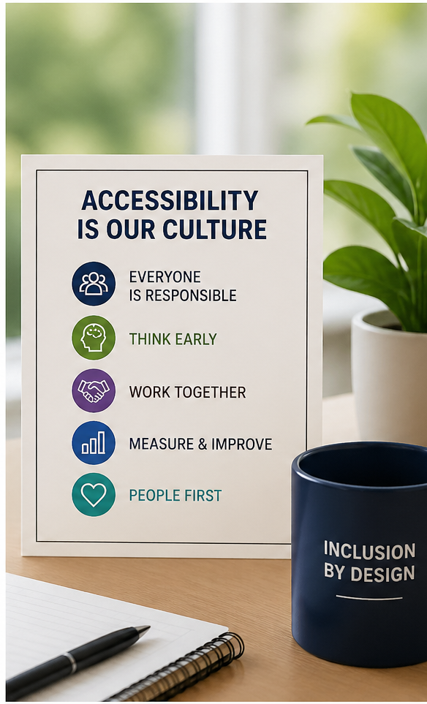
From a Checkpoint to a Culture
Building a Culture of Accessibility From the Start
Change efforts succeed when accessibility is part of how we work, every day and in every decision.
Shared Responsibility
Accessibility is everyone's job.
Think Early
Consider accessibility at the start of every project and change.
Lead by Example
Use “Champions of Accessibility“ and model the behavior.
Measure What Matters
Track progress, drive continuous improvement, avoid “gotchas”.
People First
Design for real people and real needs.
Interagency Accessibility Forum | Managing Change, Sustaining Accessibility | The National Institutes of Health
11
Notes:
This is the culture slide. The 508 program cannot be the only place where accessibility lives. Content creators and IT owners have to understand what they are responsible for. The program provides guidance, training, standards, tools, and review. But the work has to be owned where the content, applications, and services are created and managed.

Slide 12
Resources
NIH Section 508 Page
NIH Section 508 Helpdesk
Section 508 Technical Standards
Web Content Accessibility Guidelines
Section508.gov
Technology Accessibility Playbook
12
Interagency Accessibility Forum | Managing Change, Sustaining Accessibility | The National Institutes of Health
12

