Slide 1

Federal Transit Administration
Beyond the Checklist: Revolutionizing PDF Accessibility with Generative AI
May 21, 2026

Slide 2
Addressing the Accessibility Gap
Manual Bottlenecks
Universal Reach
Traditional 508 testing is slow, expensive, and subject to human error. Scaling accessibility across thousands of agency artifacts is impossible with current manual workflows.
True accessibility requires consistency. Al-driven solutions ensure every document meets compliance standards, providing unhindered access to information for all citizens, regardless of how they interact with technology.

Slide 3
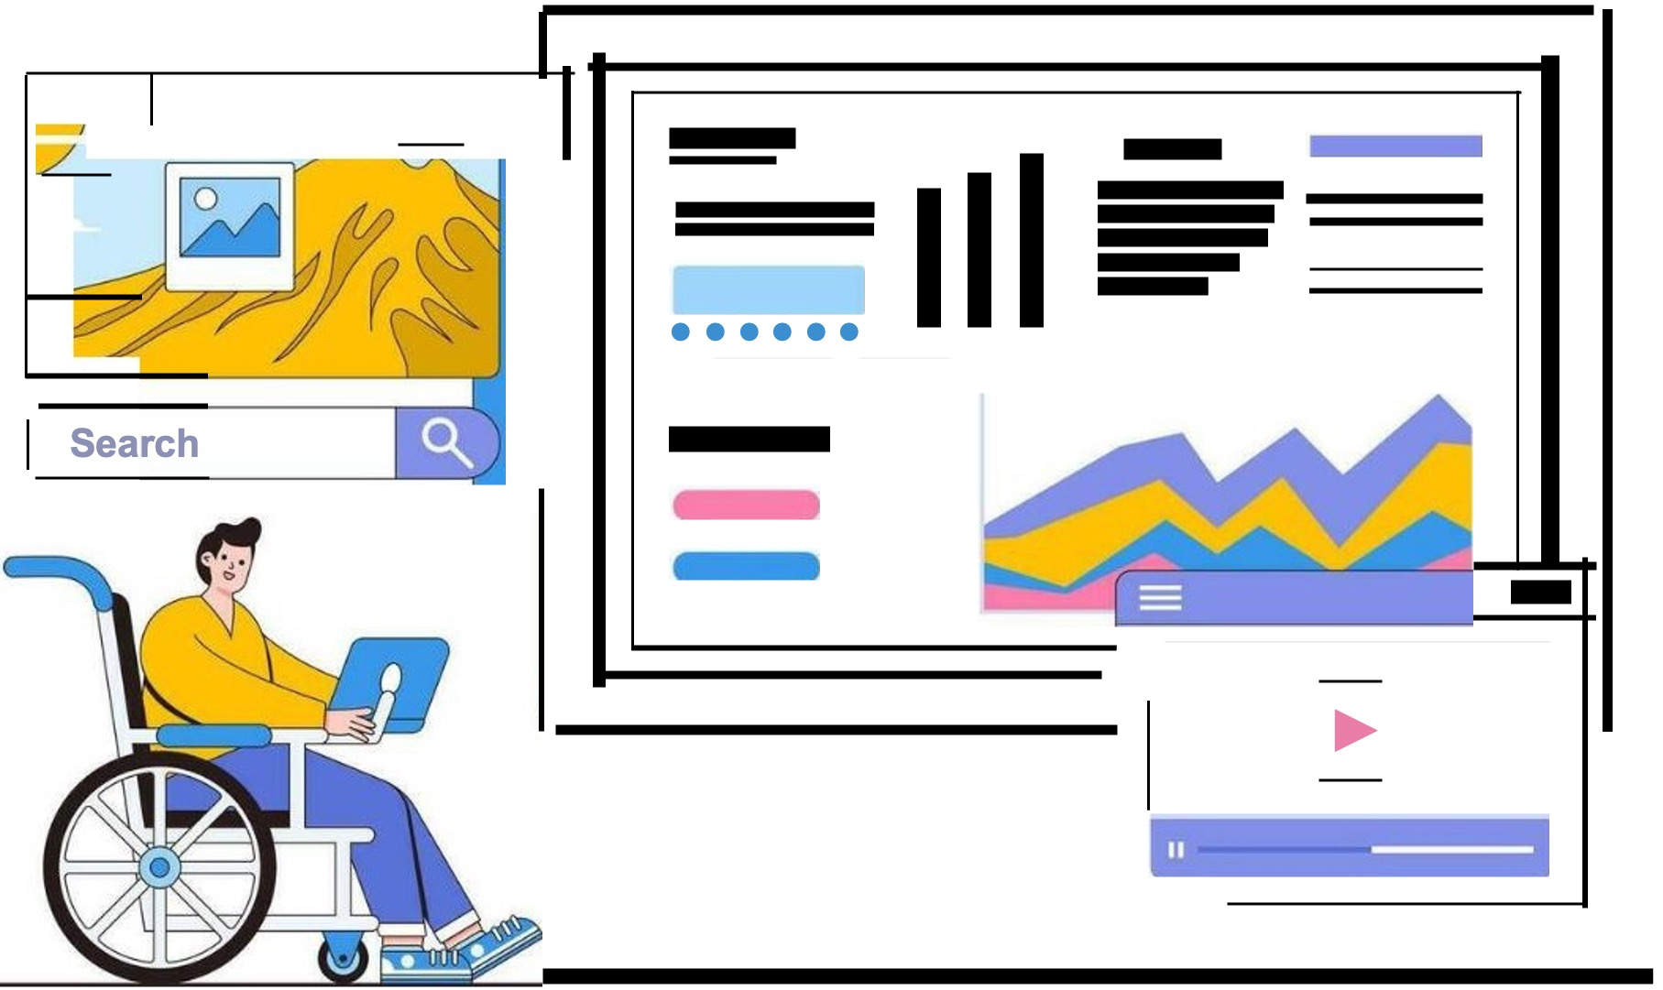
Driven By Social Responsibility
Beyond legal mandates, document accessibility is a core pillar of public service. Our tool was prompted by the need to:
Remove barriers to digital information.
Automate repetitive remediation tasks.
Maintain high accuracy in complex tagging.
Support a wide array of federal document types.
3

Slide 4
Leadership and Strategy Buy-in

Slide 5
Gaining Executive Support
Risk Mitigation: Highlighting the legal risks and public-facing impact of non-compliant digital artifacts.
Operational Efficiency: Time saved through automated background processing.
Mission Alignment: Connecting tool capabilities directly to the agency's 508 compliance concerted effort to meet the standards of Web Content Accessibility Guidelines (WCAG) 2.0, and Section 508 of the Rehabilitation Act of 1973.

Slide 6
The Engineering Behind the Engine
6

Slide 7



Technical Stack
FastAPI Backend
AWSBedrock
VAML Fix Engine
Robust Python-based backend for high-performance document parsing and task queuing.
Utilizing Nova Premier models for deep semantic analysis of document structure.
A custom remediation engine driven by validated, safe remediation registries.

Slide 8
The 508 Compliance Remediation Workflow
1. Upload
2.Analyze
3. Remediate
4.Download
1
2
3
4
User selects analysis depth and uploads artifact.
Bedrock identifies issues and severity scores.
Automated fixes applied via background tasks.
Compliant file returned with progress polling.

Slide 9
Multiple Document Format
Category | File Format | Analysis Method
Fixed Layout | PDF, HTML | PyPDF2, pdfplumber, Beautiful Soup
Office Suite | DOCX, PPTX, XLSX | Python-doc, PPTX, Openpyxl
Data Files | CSV | Converted to XLSX analysis

Slide 10
Potential Efficiencies Gained

Slide 11
The Future Improvements
Future Roadmap
Cloud Integration: Google Docs & Microsoft 365 support.
Advanced Logic: Al-generated alt-text for complex charts.
API Ecosystem: Headless remediation for agency CMS.

Slide 12
Demonstration
12

Slide 13

Images Source
https://static.vecteezy.com/system/resources/previews/024/662/340/non_2x/digital-accessibility-and-inclusive-design-concept-with-person-using-assistive-technology-vector.jpg
Source: www.vecteezy.com

