Slide 1

Scoring and Evaluating Accessibility Conformance Reports based on the VPAT
Ameenah Ghoston
May 21, 2026

Slide 2
Agenda
Overview of Section 508 Law & WCAG
Section 508 Exceptions and Exemptions, and technical standards for Software
Reading and Evaluating an Accessibility Conformance Report
VPAT Resources

Slide 3
Section 508 & Web Content Accessibility Guidelines (WCAG)
Section 508 law incorporates by reference the WCAG 2.0 specification, ISO ISO/IEC 40500:2012.
  WCAG helps ensure online content is available to all regardless of ability.
WCAG has 3 levels of conformance and complexity.
  A (lowest), AA, and AAA (highest).
A & AA level is mandatory by law, but AAA should be the goal whenever possible.
Section 508 minimal requirement WCAG 2.0 A and AA
Additionally, DHA and HHS requires WCAG 2.1 level A and AA conformance.

Slide 4
Percentage of WCAG Standards Mapping to S508 Functional Performance Criteria

Slide 5
Exceptions & Exemptions Table
Exception | Commercial (COTS) | Government (GOTS) | Notes
Best Meets Exception | Yes | No | Most common exception for GOTS
Fundamental Alteration Exception | Yes | Yes | For software which has components like maps, graphs and visualizations.
Undue Burden | No | Yes | Government cannot claim undue burden to update COTS products
National Security Systems Exception | Yes | Yes | Intelligence; cryptologic; command control of military; weapons; intel or military missions
Federal Contracts Exception | Yes | No | Contractors can purchase software for use by contractors only
ICT Functions Located in Maintenance or Monitoring Spaces Exception | Yes | Yes | Limited use software
Legacy ICT Exception | Yes but Rarely | Yes | Rarely is a commercial product not updated since 2018

Slide 6
Alternative Means: Required Documentation
Where conformance to one or more Section 508 requirements is not met, the agency shall provide individuals with disabilities access to and use of information and data by an alternative means that meets the requirements.
Plain Language: How a person with a disability will be able to interact with the capability or use the information that is not compliant
The Alternate Means must be:
  Completely documented and justified
  Functionally equivalent whenever possible

Slide 7
Criteria that apply to ALL software
  501 General
    You must complete WCAG no matter the type of software
      W3C has the document Applying to Non-Web ICT that contains details for applying WCAG
      to non-web software
      The following do not apply:
        2.4.1 Bypass Blocks
        2.4.5 Multiple Ways
        3.2.3 Consistent Navigation
        3.2.4 Consistent Identification
  Revised 508 compliance
    WCAG 2.0 Level AA is required
    Going beyond is optional

Slide 8
Criteria that apply to SOME software
  Buckets of additional criteria for:
    Non-web
    Authoring Tools
    Multimedia
    Platform Software
    Product is an Assistive Technology
  These are criteria in addition to WCAG.

Slide 9
Non-web software
  Applies to
    Non-web Software
    Command Line
    Native Mobile
  502.2.2 No Disruption of Accessibility Features
  502.3.x Accessibility Services (14 items)
  503.2 User Preferences

Slide 10
Multimedia
  503.4.1 Caption Controls
  503.4.2 Audio Description Controls

Slide 11
Authoring tools
  504.2.1 Preservation of Information Provided for Accessibility in Format Conversion
  504.2.2 PDF Export
  504.3 Prompts
  504.4 Templates

Slide 12
Platform
  502.2.x Interoperability with AT (2 items)
  502.3.x Accessibility Services (14 items)
  502.4 Platform Accessibility Features
  503.2 User Preferences

Slide 13
Assistive Technology
503.3 Alternative User Interfaces

Slide 14
Criteria that apply sometimes
  302 Functional Performance Criteria (FPC)
  302.1 Without Vision
  302.2 With Limited Vision
  302.3 Without Perception of Color
  302.4 Without Hearing
  302.5 With Limited Hearing
  302.6 Without Speech
  302.7 With Limited Manipulation
  302.8 With Limited Reach and Strength
  302.9 With Limited Language, Cognitive, and Learning Abilities

Slide 15
Section 508 Software Criteria Summary
Software Criteria | Web UI Web Docs Non-web Docs | Non-Web UI CLI Native Mobile | Authoring Tool | Multimedia | Platform | AT
501.1 Scope – Incorporation of WCAG 2.0 AA | X | X | X | X | X | X
502.2.1 User Control of Accessibility Features | N/A | N/A | N/A | N/A | X | N/A
502.2.2 No Disruption of Accessibility Features | N/A | X | N/A | N/A | X | N/A
502.3.x Accessibility Services (14 items) | N/A | X | N/A | N/A | X | N/A
502.4 Platform Accessibility Features | N/A | N/A | N/A | N/A | X | N/A
503.2 User Preferences | N/A | X | N/A | N/A | X | N/A
503.3 Alternative User Interfaces | N/A | N/A | N/A | N/A | N/A | X
503.4 User Controls for Captions and Audio Description | N/A | N/A | N/A | X | N/A | N/A
504 Authoring Tools | N/A | N/A | X | N/A | N/A | N/A

Slide 16
Section 508 Conformance:
Procuring ICT Products and Services
Process
The Federal Acquisition Regulations (FAR) subpart 39.2 provide a detailed process for purchasing products and services for the Federal government.
Work with the Contracting Officer and Section 508 Program Manager assigned to your program. Requirements (Statement of Objectives, Statement of Work, Performance Work Statement)
Be sure to include Section 508 technical standards when developing requirements documents for procurements.
Make sure the requirements in the contract are specific to the product or service that is being purchased.
Standardized contract language that states the product must be Section 508 conformant is insufficient.

Slide 17
2025 Annual Assessment
  How often is Section 508 compliance considered in market research?
  How often do ICT solicitations include all applicable ICT accessibility requirements?
  How often is Section 508 compliance considered in the technical evaluation of proposals related to ICT services and products prior to award?
  How often are compliance or performance clauses (e.g., remediation responsibilities, non-compliance penalties, response and resolution times for accessibility issues, etc.) included in contracts to hold vendors accountable for providing accessible ICT?
  How often are non-conformance issues escalated to vendors or contractors when accessibility defects are found?
  How often are ICT deliverables from a contract verified for Section 508 conformance?
  Does the COMPONENT use a governance, risk, and compliance (GRC) tool, separate from its Department or Agency, to manage accessibility compliance and the risks associated with non-conformance?

Slide 18
What is a VPAT?
At their heart, VPATs are just templates used to draft Accessibility Conformance Reports (ACRs).
These reports consists of:
  Descriptions of the product or service being evaluated
  Accessibility standards it meets (or doesn’t)
    Why this is the case, and any potential workarounds (if possible).
It’s important that a current version of the VPAT be used to ensure that the proper guidelines are being assessed
  The current version is 2.4 (2.5, November 2023 but minor change) and no version prior to January 2018 (when the Refresh went into effect) should be accepted).

Slide 19
VPAT vs. ACR
  VPAT = Voluntary Product Accessibility Template
  vs.
  ACR = Accessibility Conformance Report
  The VPAT is:
    A document template used to create an ACR
    Prepopulated with the standards (and guidelines) criteria and instructions
  An ACR is:
    The filled out VPAT – answering how the product meets the criteria
    Reports conformance to accessibility standards

Slide 20
Why was the VPAT developed?
    Procurement tool
      Helps Federal agencies and other buyers determine accessibility of information technology products and services
    Self-assessment tool
      Provides a framework for companies to evaluate their own products
      Consistent format
      Makes comparing products easier when companies use the same reporting mechanism
    Address levels of support
      Enable showing how well products support each requirement

Slide 21
Is accessibility a yes/no question?
    Vendors are asked to give yes/no answers to 'Is the product accessible?'
      It ignores the complexity involved in conforming to accessibility standards
      ACR helps to report the “degree of conformance”
    Reporting Conformance to ICT Accessibility Standards (August 06, 2019)
      A white paper on why a yes/no answer for accessibility doesn't work

Slide 22
Is the ACR a certification?
    The ACR is a statement of conformance
      It is not a certification
      It states how well the product conforms to each of the criteria listed for a standard

Slide 23
VPAT Editions
    Four editions
      VPAT-WCAG (includes all WCAG versions 2.0/2.1/2.2)
      VPAT-508 (includes Section 508 standards and WCAG 2.0 Level A&AA)
      VPAT-EU (includes EN 301 549 and WCAG 2.1 Level AA)
      VPAT-Int (includes all digital accessibility standards –all the above
    Current version of the VPAT format is 2.5

Slide 24
Which VPAT edition to use
    Depends on:
      Your customers’ requirements
      Marketing requirements for your company
      Plans to distribute (Europe, U.S. only, international)

Slide 25
Reading and Evaluating an Accessibility Conformance Report

Slide 26
Part 1: Basic Descriptors
The first part of the VPAT consists of basic information about the product
This includes:
  Name
  Report Date
  Product Description
  Contact Information
  Notes
Though most of this information is relatively standard, it’s worth paying extra attention to the notes as any caveats, overall issues, or exemptions will appear here
  Otherwise, the notes section will be left blank

Slide 27
Part 2: Evaluation Methods Used (1 of 2)
This section details who conducted the evaluation (what person, company, service, etc.) and how that evaluation was conducted.
For example, it could say site x was evaluated on a Windows 10 desktop using Google Chrome version 94.3.5, JAWS 18 (more detailed version information is preferred, but not always provided), and the ZoomText magnifier. It was tested exclusively with keyboard controls to ensure that users could successfully navigate without the use of a mouse.
This sort of description is the bare minimum that’s acceptable, but more detail is preferred.

Slide 28
Part 2: Evaluation Methods Used (2 of 2)
VPATs should be conducted by reputable accessibility experts and/or companies with a solid reputation for providing thorough and detailed analyses.
Also be sure that analyses were conducted on all relevant platforms.
  For example, if a service is going to be used primarily on mobile, but the VPAT notes that it was only tested on a desktop, that can be a red flag.

Slide 29
Applicable Standards/Guidelines
This section has a standard format and should look like this:
Standard/Guideline | Included In Report
Web Content Accessibility Guidelines 2.0 | Level A (Yes / No ) Level AA (Yes / No ) Level AAA (Yes / No )
Web Content Accessibility Guidelines 2.1 | Level A (Yes / No ) Level AA (Yes / No ) Level AAA (Yes / No )
At the bare minimum, Level A and AA for WCAG 2.0 guidelines must have an answer of ‘Yes’. If some answers are ’No’, then an exception must be requested.
If answers are missing, then the VPAT is invalid as it did not test at the legal threshold (the law states that WCAG 2.0 AA standards must be met on all federal government sites, software, etc.).

Slide 30
WCAG Report
The next sections of the VPAT are split by conformance level and whether they are requirements for level A, AA, or AAA
In order to reach compliance, all elements of the A and AA must be either supported or partially supported with adequate explanations of alternate means to meet that criteria
Full template can be downloaded from:
https://www.section508.gov/sell/vpat/
Another good source is:
https://www.itic.org/policy/accessibility/vpat-training

Slide 31
Terms
This section also has standard wording and should look like this:
  The terms used in the Conformance Level information are defined as follows:
  Supports: The functionality of the product has at least one method that meets the criterion without known defects or meets with equivalent facilitation.
  Partially Supports: Some functionality of the product does not meet the criterion.
  Does Not Support: The majority of product functionality does not meet the criterion.
  Not Applicable: The criterion is not relevant to the product.
  Not Evaluated: The product has not been evaluated against the criterion. This can be used only in WCAG 2.0 Level AAA.

Slide 32
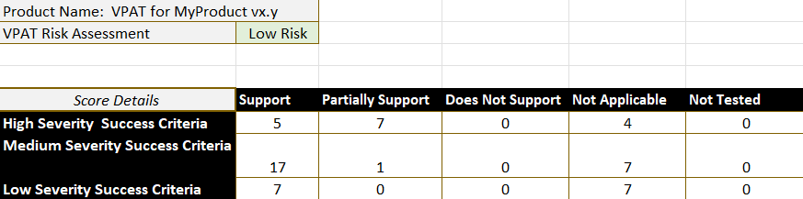
VPAT Scoring Matrix
The VPAT scoring matrix:
A comprehensive tool designed to evaluate and score the accessibility support of products based on the VPAT.
Serves as a systematic framework to assess how well a product aligns with Section 508 and WCAG.
Provides an objective way to measure accessibility compliance and compare products in terms of accessibility conformance.

Slide 33
The need for a scoring matrix
VPATs provide useful information but reviewing them manually across multiple vendors can be time-consuming and inconsistent.
The scoring matrix allows us to:
  Standardize review of vendor submissions
  Speed up comparisons across products
  Help identify accessibility risks
  Support consistent internal decision making
  Prioritize where deeper testing is needed.
The VPAT scoring matrix is a decision-support tool, not a replacement for accessibility testing.

Slide 34
How the VPAT scoring matrix works
Input
Evaluation
Severity Weighting
Supports
Partially supports
Does not support
Not applicable
Lowest risk
Moderate risk
Highest risk
Excluded/Neutral
Each criterion is also weighted based on impact such as:
  High – Prevents access to core tasks
  Medium – Major barriers
  Low – Minor impact

Slide 35
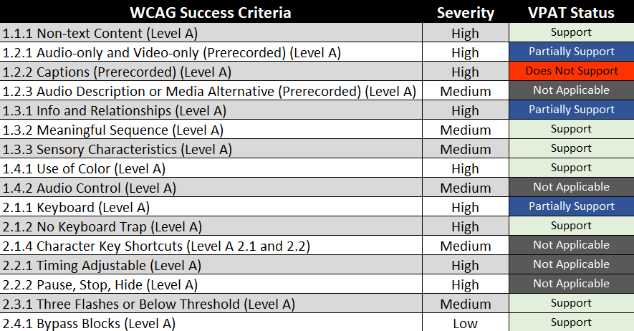
Why severity weighting improves results
Without severity
  Two vendors both have 5 unsupported success criterion
With severity
  Vendor A = Fails images of text
  Vendor B = Fails keyboard access
Not all accessibility issues carry the same user impact. Similar to leading accessibility platforms such as deque and Level Access, our team uses a structured scoring model that combines conformance responses with severity levels to support prioritization and decision making.

Slide 36
Automated scanning
Automated scanning tools:
  Detect 30% WCAG failures.
  Can partially flag criteria.
  Cannot reliably determine many criteria requiring human judgement.
Automated tools are strongest at detecting:
  Code-level issues.
  Missing labels.
  Missing alt text (does not validate alt text accuracy).
  ARIA Errors.
  Structural markup issues.

Slide 37
Automated tools and WCAG success criterion
Examples of some WCAG criteria commonly detected well:
  Perceivable
    1.1.1 Non-text content – Can often detect missing alt text and image buttons without names. Cannot judge quality of alt text
    1.3.1 Info and Relationships – Missing form labels, missing table headers, incorrect heading structure, lists not marked up, etc.
  Operable
    2.4.2 Page Titled
    2.4.6 Headings and Labels – Can flag missing headings or empty labels
  Understandable
    3.3.2 Labels or Instructions – Can detect missing labels, not adequacy of instructions

Slide 38
Additional questions for Authoring Tools
Does this tool comply with ATAG and WCAG 2.1 requirements?
Does the tool itself accessible to users with disabilities?
Can users customize font sizes, colors, and contrast settings?
Does the tool offer pre-built templates that meet WCAG standards?
Are these templates customizable while retaining accessibility?
Does it provide actionable feedback to fix accessibility issues?
Does the tool provide guidance, tutorials, or wizards to help users create accessible contenta?
Does the tool provide option to customize the UI components naming conventions or other information if needed?
Are there accessibility experts available to assist users?
How often is the tool updated to meet new accessibility standards?
Does the vendor provide accessibility patches or fixes?

Slide 39
Checklist Overview
This checklist is intended to be used as a ‘first line of defense’ for the acquisitions team to determine whether a VPAT/ACR is satisfactory before passing software off to internal testers.
If any item on this list is not met, the VPAT/ACR should not be accepted until it is corrected.

Slide 40
Buyer’s VPAT/ACR Checklist
Questions | Response
Does the VPAT cover the version of the software that you wish to purchase?
Does the description of the product match what you thought you were purchasing?
Was the VPAT conducted by an outside agency?
If so, is it one that is reputable (for example: Deque, Perkins Access, TPGi)
If the VPAT was conducted internally at the vendor, do they list their methodology?
If so, does their methodology cover the use cases the software is being purchased for?
Does the standards/guidance section have 'Yes' answers for WCAG 2.0 at the A and AA level?
Are Table 1 (Level A Success Criteria) or Table 2 (Level AA Success Criteria) filled out with no empty cells?
All criteria relevant to use cases the software is being deployed for have ratings of 'Supports' or 'Partially Supports, and if partial, satisfactory explanation is provided for an alternative methodology for the function
Response:
  Supports
  Partially Supports
  Does Not Support
  Not Applicable
  Not Evaluated

Slide 41
VPAT Resources
  VPAT Files
    https://www.itic.org/policy/accessibility/vpat
  How to meet WCAG 2.2
    https://www.w3.org/TR/WCAG22/#requirements-for-wcag-2-2
  WCAG2ICT Overview
    https://www.w3.org/WAI/standards-guidelines/wcag/non-web-ict/

