Slide 1

The NPS.gov Media Player and Media Workflow: An Accessible Option for All Government
May 21, 2026

Slide 2

Presenter
Sid Sharma
Section 508 Program Manager
Department of the Interior

Slide 3
Presentation Outline
  Accessibility of the media player controls
  Accessibility of media content
    Captions
    Audio Description
    Handling audio-only and video-only content
    American Sign Language
Notes:
First, I’ll talk about the media player itself, and what makes a media player accessible.
Next, I’ll talk about what makes the content we show via the media player accessible and how we enforce accessibility conformance on National Park Service media.

Slide 4
Media Player Controls Requirement
503.4 User Controls for Captions and Audio Description: Where ICT displays video with synchronized audio, ICT shall provide user controls for closed captions and audio descriptions. ​

Slide 5
Caption Controls
503.4.1 Caption Controls: Where user controls are provided for volume adjustment, ICT shall provide user controls for the selection of captions at the same menu level as the user controls for volume or program selection.​

Slide 6
Audio Description Controls
503.4.2 Audio Description Controls: Where user controls are provided for program selection, ICT shall provide user controls for the selection of audio descriptions at the same menu level as the user controls for volume or program selection.​

Slide 7
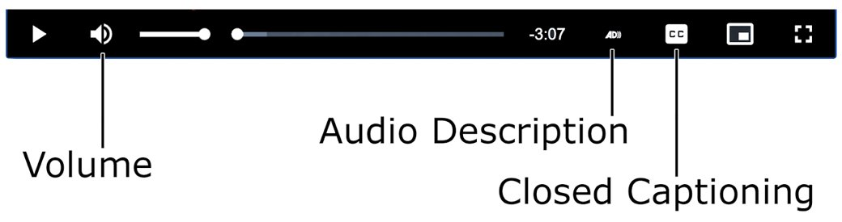
Close up Example of Accessible User Controls

Slide 8
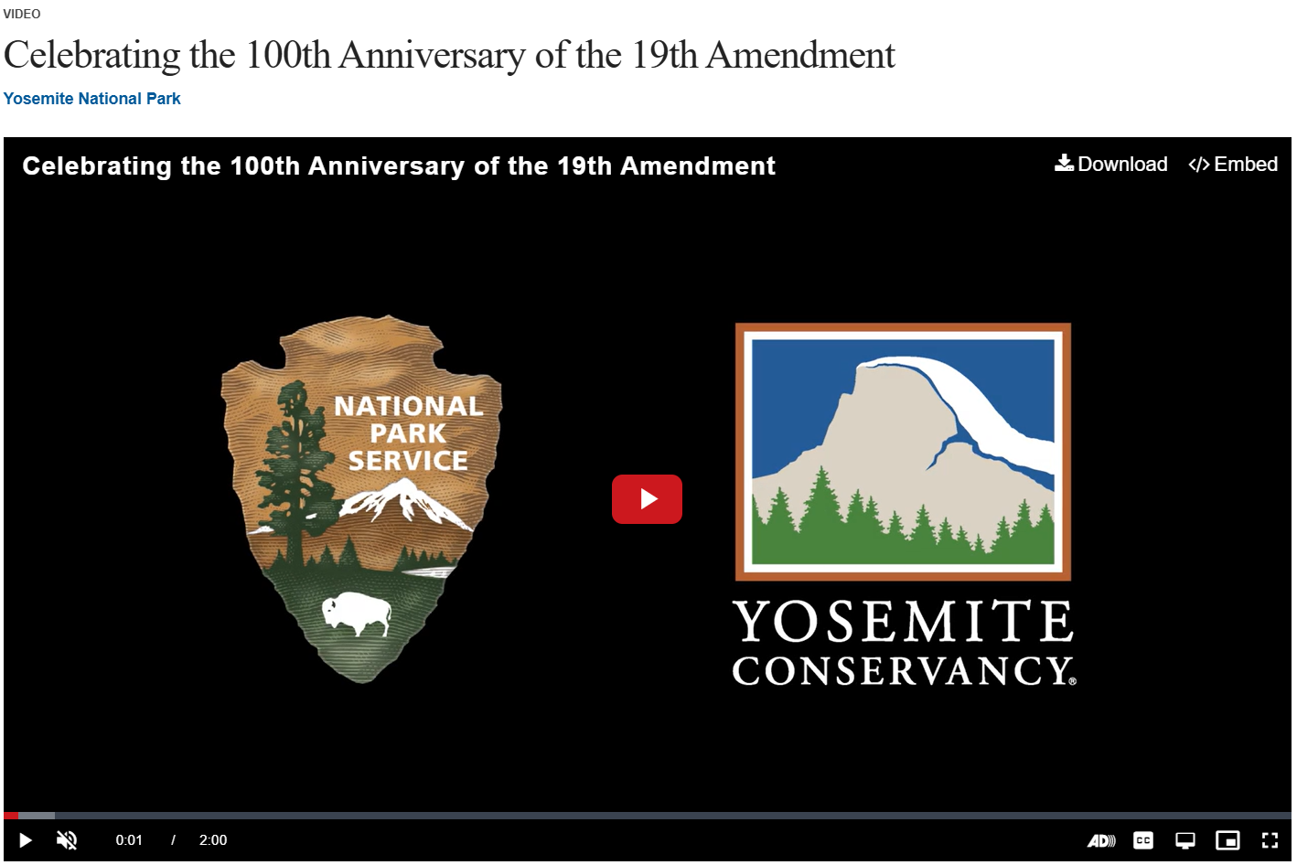
Example of the NPS Media Player
Notes:
On the screen is a large example of a video from Yosemite, paused on a splash screen with the NPS and Yosemite Conservancy logos, just to offer the media player controls in context with the larger video.

Slide 9
Captions
1.2.2 Captions (Prerecorded): Captions are provided for all prerecorded audio content in synchronized media, except when the media is a media alternative for text and is clearly labeled as such. (Level A)
Our player:
Supports closed captions in 12 languages
Allows authors to indicate if video is open-captioned
Transcript field also available
Notes:
The definition of what makes multimedia accessible can be found in the Web Content Accessibility Guidelines, in a couple of different success criteria.
First up, captions. Success Criteria 1.2.2 addresses captions for pre-recorded media states: Captions are provided for all prerecorded audio content in synchronized media, except when the media is a media alternative for text and is clearly labeled as such. (Level A)
Audio content includes all audible sounds, which must be written into the captions, not just human speech.
Lastly, we offer a transcript field. This isn’t required at Level A or AA for synchronized multimedia content, but it can be helpful.

Slide 10
How to Create & Use Captions
Decide on Type
Generate Captions
Apply Captions
Open captions are always visible
Closed captions are user-controlled
Options:
Pay someone else to do it
Start with AI, edit for accuracy
Manually transcribe
If open: Edit them into your video directly
If closed: Upload a closed caption file with the video
Notes:
Creating accessible controls is only as useful if you have captions at all, so let’s talk about how to create captions.
First, you must decide if you want your captions to be open or closed. Open means they are always visible in the video. Closed means the video user must click a button to show or hide them.
Second, the real lift: You must generate your captions. There are three general ways to do this, which I will summarize
Pay someone else! There are a ton of captioning services in the world. In my experience, it’s typically about $1.50 per video minute.
Start with automation or AI. Uploading your video to a service that auto-captions video, such as Microsoft OneDrive or YouTube. Then, manually edit the captions to ensure accuracy. Never rely 100% on automation without verifying the output. You typically can do this in the same interface where you uploaded the video.
The final option: you could just manually type captions for your video. This will take a bit longer, and you will need to know how to format the file properly if you want closed captions, but it gives you 100% control over accuracy right from the start. This is also sometimes the easiest approach when you are creating open captions. Many tools, like OneDrive or YouTube, will let you upload a transcription to your video and it will automatically sync the transcript to the video, thus giving you timed captions.
Third, you need to apply your captions to your video.
If you want open captions, you need to go to your video editing software and look for how you can apply open captions.
If you want closed captions, you’ll create a file (typically .SRT or .VTT, though many caption file formats exist). If you used a tool like OneDrive or YouTube, you can download that caption file and reuse it anywhere else you publish the video, such as on your government website.

Slide 11
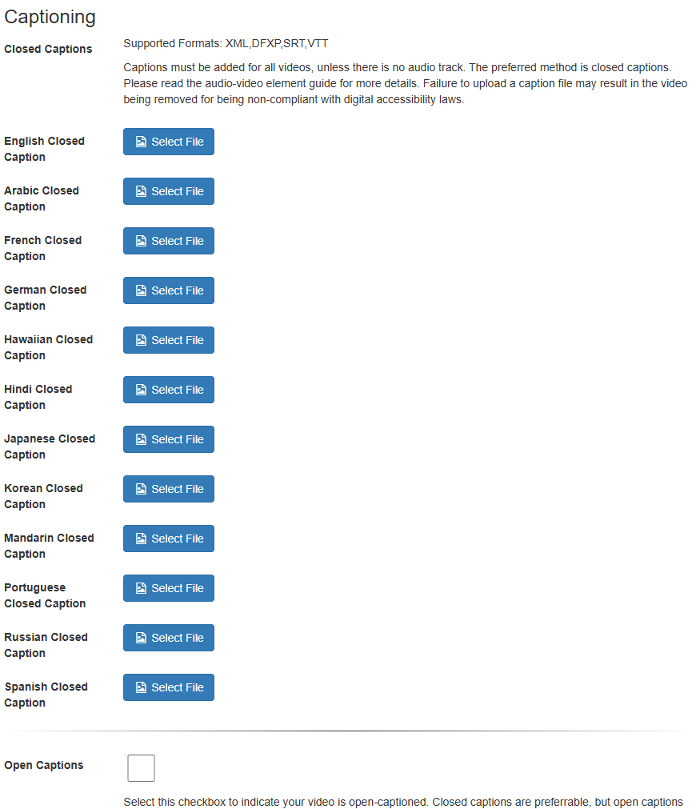
Uploading Captions in the NPS System
We require our authors to either upload a closed caption file or check a box indicating that their video has open captions. We prefer for our authors to use closed captions, but there are occasions when open captions make more sense.
We support a variety of closed caption formats: XML, DFXP, SRT, and VTT. We automatically convert these formats to VTT.
Currently, the NPS system supports uploading closed caption files in English, Arabic, French, German, Hawai’ian, Hindi, Japanese, Korean, Mandarin, Portuguese, Russian, and Spanish.
Notes:
We require our authors to either upload a closed caption file or check a box indicating that their video has open captions. We greatly prefer for our authors to provide closed captions, but we know there are occasions when open captions make more sense, such as when a video is initially created to play in a visitor center theater, and then later the park wants to publish the same video online.
We support a variety of closed caption formats: XML, DFXP, SRT, and VTT. We automatically convert these formats to VTT.
We also optionally allow authors to upload captions in various languages, partially because our authors sometimes make videos that do not use English (e.g., parks in Hawai’I publishing videos that are in Hawa’ian, and thus require that language of captions), and partially to offer subtitles for non-English speakers.

Slide 12
Audio Description
1.2.3 Audio Description or Media Alternative (Prerecorded): An alternative for time-based media or audio description of the prerecorded video content is provided for synchronized media, except when the media is a media alternative for text and is clearly labeled as such. (Level A)
Notes:
Success Criteria 1.2.3 articulates that we must make our media accessible to people who are blind or low vision, by providing audio description. The full text of the criteria reads: An alternative for time-based media or audio description of the prerecorded video content is provided for synchronized media, except when the media is a media alternative for text and is clearly labeled as such. (Level A)

Slide 13
How to Create & Use Audio Description (AD)
Decide on Type
Generate AD
Apply AD
Standard: Fits into existing pauses
Extended: Pause the video periodically to allow for lengthier description
Options:
Pay someone else to do it
Start with technology, edit for accuracy
Record yourself
Edit into the existing video
Create a new version of the video
Notes:
First, decide if standard AD is sufficient, or if you need expanded AD. With standard, you’ll use existing pauses or quiet moments in your video to describe the immediate or following scene. This can work well sometimes, but not always. If standard isn’t sufficient, consider expanded AD, where you edit your video to insert pauses of whatever length needed to adequately describe the immediate or following scene.
Second, generate your audio description. As with captions, there are three general ways:
Pay someone to do it. There are many companies in the world who provide audio description services.
Use automation. There are two sort of sub-methods here
Trust AI. I won’t, but you might. There are new tools that claim they can generate description based off what is visible in a video
Use a text-to-speech tool. These work in different ways, but in general, you’re still manually writing out descriptions of each scene, and then relying on software to voice those descriptions.
Write out your descriptions and record it in-house. This gives you the most control over the quality of the descriptions.
Finally, no matter how you create your AD, you’ll need to figure out how to use it. If you opted for standard AD, you’ll need to edit the AD into your existing video, using your video editing software (or ask your vendor to do so, if you’re contracting out the whole thing).
If you’re using extended AD, you should create an entirely new version of your video with the extended description. This will likely mean the runtime of your described video is longer than your original video, but that is not a big deal with our solution, as I mentioned on the prior slide.

Slide 14
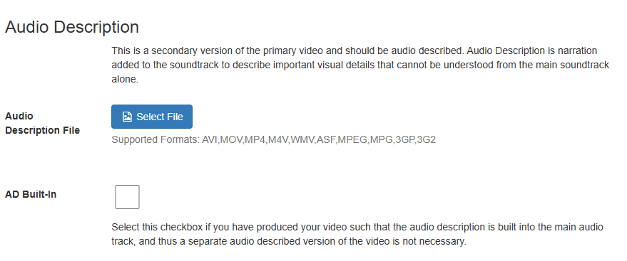
Uploading Audio Description in the NPS System
In the NPS workflow, content creators must either upload an audio described version of their video or click a checkbox to indicate that the main narration of the video is descriptive.
The duration of the audio described version doesn’t need to match the duration of the standard video.
Our player is then able to let the end user toggle between a standard and a described version of the video.
Notes:
In the NPS workflow, content creators must either upload an audio described version of their video or click a checkbox to indicate that the main narration of the video is descriptive. This built-in descriptive approach works well for some NPS videos, e.g., where a park ranger is doing a short lecture and there aren’t many changes in scenery, etc. But in general, it is better for the author to create an audio-described version of their video.
The duration of the audio described version doesn’t need to match the duration of the standard video.
The media player is then able to let the end user toggle between a standard and a described version of the video.

Slide 15
Audio-only and Video-only Content
1.2.1 Audio-only and Video-only (Prerecorded): For prerecorded audio-only and prerecorded video-only media:
Prerecorded Audio-only content: An alternative for time-based media is provided...
Prerecorded Video-only: Either an alternative for time-based media or an audio track is provided...
Our method:
Offer authors a checkbox to indicate when content is video-only.
Allow for a descriptive transcript in such cases.
Notes:
It’s worth discussing edge cases, too – specifically, what about audio-only and video-only content?
Success criteria 1.2.1 addresses audio-only and video-only content for prerecorded media. It states, in part:
For prerecorded audio-only and prerecorded video-only media:
Prerecorded Audio-only content: An alternative for time-based media is provided
Prerecorded Video-only: Either an alternative for time-based media or an audio track is provided
If the file the content creator uploads is an mp3, we know by default that it is audio-only content. In that case, we simply require that they provide a transcript, and do not require captions or audio description.
If the file is not an mp3, we know it’s a video file. But we won’t know if it is video-only content without some help from the author. In NPS, the most common type of video-only content is a timelapse generated from a bunch of still images.
When a creator uploads a video file in our system, a checkbox is available for the author indicate that the video has no audio of any kind. Help text reminds them that we’re not only concerned with speech content, but audio of any kind, including ambient sounds, music they laid over the video, etc. If any audio is present, they must have captions.
If they indicate that the file is video-only, we then require they either:
Upload an audio-described version, or
Write a descriptive transcript, which falls into the “alternative for time-based media” (see WCAG article on transcripts for details: https://www.w3.org/WAI/media/av/transcripts/#checklist)

Slide 16
American Sign Language
Sign language is not required in most web accessibility policies.
Sign language is in the WCAG standard at Level AAA: Understanding 1.2.6 Sign Language.
Our player does support ASL, if the author has a sign language version available.
Notes:
WCAG does not mandate American Sign Language for media files at the 2.0 A & AA levels, but it is in the Level AAA requirements. As part of the US federal government, we’re only legally required to meet Levels A & AA, but we want to make it possible for our authors to achieve higher conformance if they wanted.
So, we offer an option for our authors to upload a version of their video with ASL, if they have it. This way, the standard and the signed versions of the videos are inherently connected, making it much easier for the public to switch from one to the other version. If they do this, then the media player shows an American Sign Language button alongside the AD and closed caption buttons.

Slide 17
Ensuring Accessibility Conformance
Monthly scans
De-publishing inaccessible content
Notes:
Lastly, all of this works well to ensure NPS publishes only accessible audio/video content.
We check all content each month, and if a file is not accessible, we hide it from public view. Authors are then emailed a notification of the action, and they can then remedy the problem(s) and republish their videos when they are ready.

