Slide 1
Navigating Section508.gov
What’s New, What’s Changed, and How to Use It
presented by
Michael Horton | Government-wide IT Accessibility Program | June 9, 2026

Slide 2
Overview
29 U.S.C. §794d.b. Technical Assistance: The Administrator of General Services and the Access Board shall provide technical assistance to individuals and Federal departments and agencies concerning the requirements of this section.
Section508.gov allows our team to share guidance and best practices regarding common issues that buyers, developers, testers, content creators, and each employee who has a responsibility to ensure that agency information and communications technology is accessible to everyone—including people with disabilities.

Slide 3

Key functions of the website
A
B
C
D
Central hub for federal ICT accessibility guidance
Supports Section 508 compliance and implementation
Connects policy, practice, tools and techniques
Serves multiple roles across government

Slide 4
Agenda
1
2
STRUCTURE: Learn how to explore, find, search and share resources you need to help you and your agency Buy. Build. Be Accessible.
WHAT’S NEW?: Discover how you can find information and guidance published by the team—everything new, or anything at all!
3
4
HIGHLIGHTS: Explore key additions that can help stakeholders improve their programs, and SMEs procure, develop, and test for conformance.
DEMONSTRATIONS. We’ll spend some time on the live site exploring content and features so you are more familiar with what’s available.

Slide 5
Structure: Primary Navigation Channels
Section508.gov includes six primary channels in which information and guidance is organized:
Policy & Management: Governance, law, policy, accessibility program guidance, and reporting.
Acquisition: How to buy on behalf of the government, and sell accessible ICT to the government.
Content Creation: Documents, videos, and common components such as alt text and use of color.
Design & Develop: Designing principles for accessibility, development research and user stories.
Testing: Lifecycle, Methods, Tools for Testing, Baseline Portfolio, Trusted Tester process.
Training, Tools & Events: Online training, video library, upcoming events, and tools.
The navigation in the header also includes four key components for quick access:
What’s New!: Quick access to the newest additions and updates to Section508.gov.
My Agency’s 508 PM: A list of, and contact information for federal agency Section 508 PMs.
Content Library: An advanced tag-based dynamic filter of all of the content hosted on the site.
Search: Powered by Search.gov, our search engine allows us to promote “best bet” search results.

Slide 6
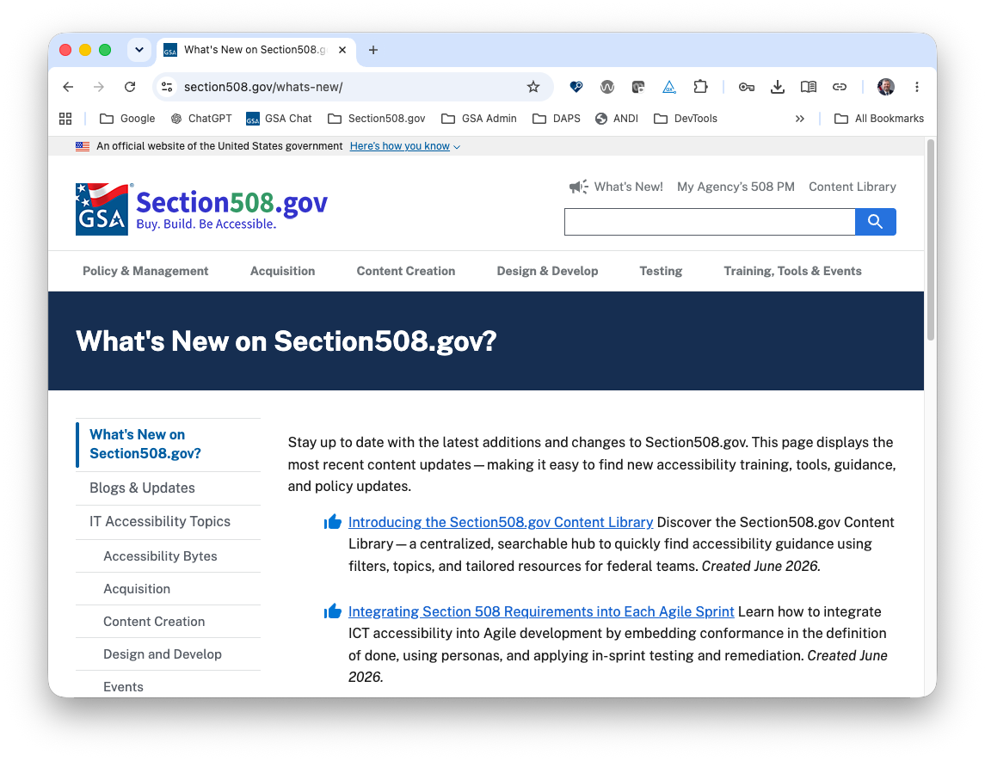
What’s New: On Section508.gov
What’s New and How it Works
Automatically displays content created or updated within the last 30 days
Prioritizes the most recent and relevant updates
Supports discoverability of newly published guidance and refreshed resources
Helps returning users quickly identify changes since their last visit or the last update
Editorial tools allow us to pin or hide content that’s “new”

Slide 7
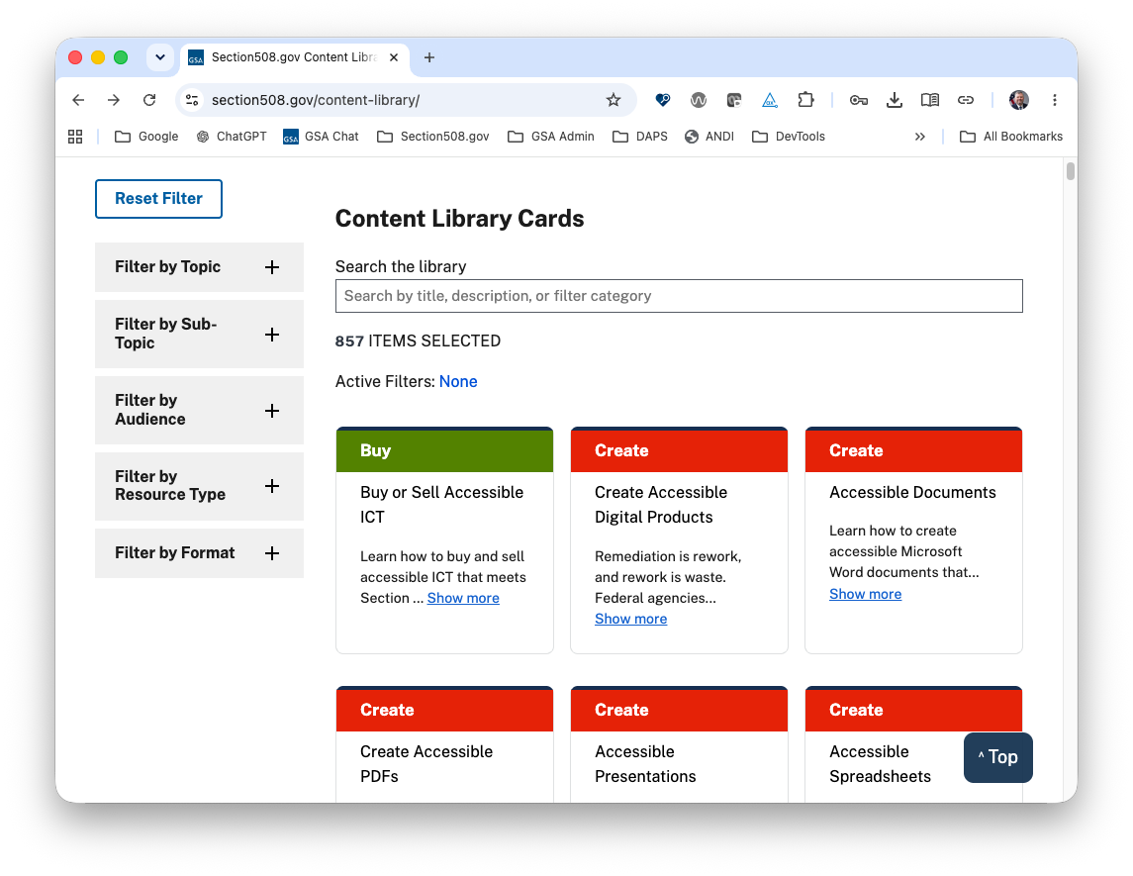
What’s New: Section508.gov Content Library
The Content Library aggregates resource tagging across the site into a searchable and filterable experience that supports multiple user needs and workflows.
Users can:
Search by keyword
Filter by:
  Topic & sub-topic
  Audience (role)
  Resource type
  Format
Includes documents & webpages.

Slide 8
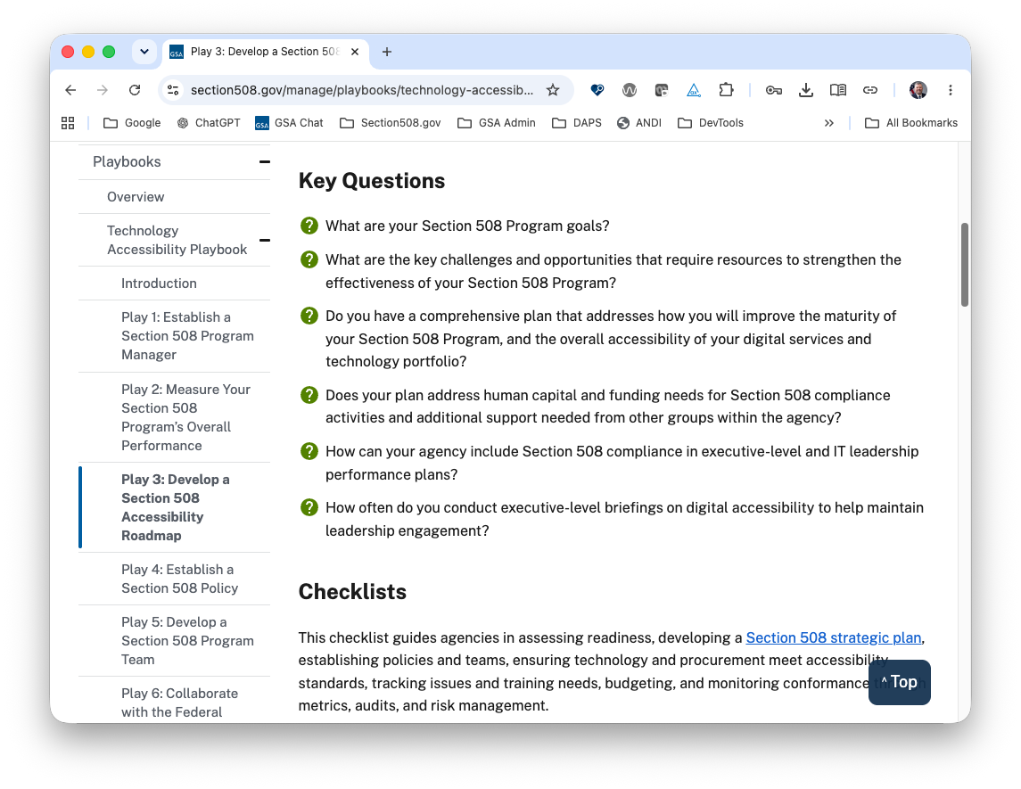
Technology Accessibility Playbook
Updated in April, we completed an extensive update to the Technology Accessibility Playbook to review, update, and standardize.
Common structure:
Key Questions
Checklists
  Basic
  Advanced
Key Performance Indicators
Related Resources
Includes documents, spreadsheets.

Slide 9
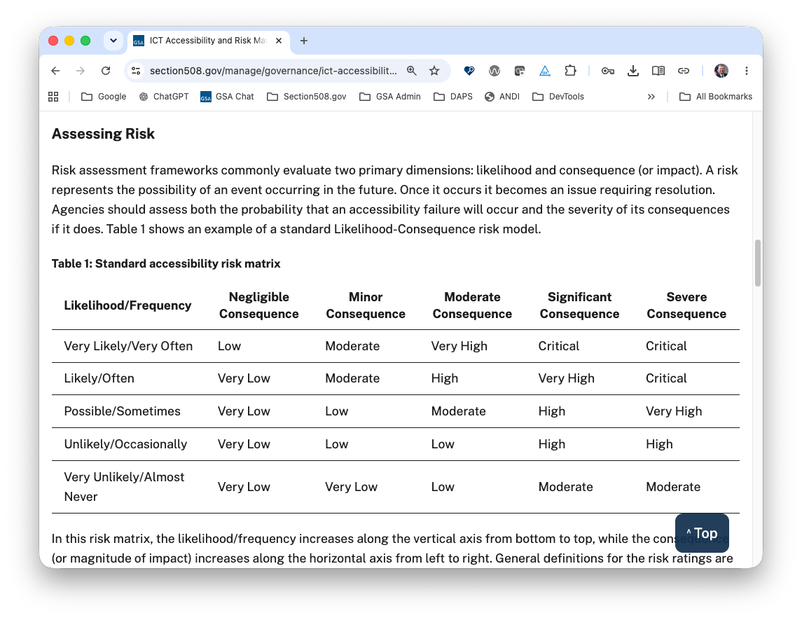
ICT Accessibility and Risk Management
Key Risk Management topics:
Enterprise Risk Management Framework
Accessibility in the Context of Enterprise Risk Management
Addressing the Risk
Assess Risk At Your Agency
Downloads:
Accessibility risk input template (XLSX)
Example accessibility risk factors (XLSX)
Example risk list (XLSX)

Slide 10
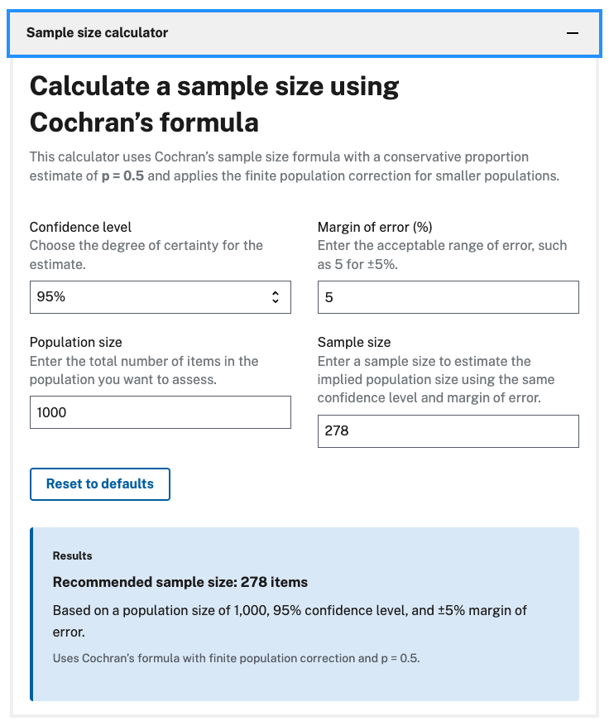
Sample vs Comprehensive Testing
The Sample Size Calculator can help you learn how to choose between sample-based and comprehensive accessibility testing to efficiently meet Section 508 requirements while balancing accuracy, risk, and resources.
Users can adjust calculations by:
Confidence level
Margin of error (%)
Population size
Sample size

Slide 11



Channels Highlights & Demo
The following slides reflect the live demonstration, showcasing the key features and guidance as they were presented in real time.

Slide 12

Policy & Management
Governance: Agency-wide responsibility integration. See EA, GRC, CPIC, and FITARA
Policy Framework: Integrate Section 508 into the policy review process—includes auditing tools
Law & Policy: Section 508 and other regulation that supports the creation/maintenance of accessible ICT
Management: For 508 PM and others responsible for integrating accessibility into the mission steady state. See: Roles & Responsibilities, PdM & PjMs, and KPIs
Playbooks: Technology Accessibility Playbook organizes Section508.gov into 12 “plays” to help PMs establish and mature their agency-wide programs.
Reporting Requirements: Regulations on reporting
Annual Section 508 Assessment report to Congress
IT Accessibility FAQs: Basic questions, answered

Slide 13

Acquisition
Buy: For Federal employees buying ICT products and services on behalf of their agencies
  ART: Generate standardized contract language
  Exceptions: Understand exceptions to §508 conformance and how to adjudicate
  SRT: Automated evaluation of ICT solicitations
  ACRs: Understanding vendor claims
Sell: For Vendors looking to sell their ICT products and services to the federal government
  ACRs: Resources for writing your product claim
  ACR Editor: Create machine readable ACRs
  ACR FAQ: Common questions, answered

Slide 14

Content Creation
Learn how to create electronic documents and other content:
Documents: Learn basics of structure and formatting
PDFs: Learn how to tag and format for readability
Presentations: Ensure access to logical information
Spreadsheets: Ensure table data can be accessed
Audio & Video: Captions, transcripts, text alternative
Learn how to create content common to the authoring tools used across government:
Alt Text: Create meaningful descriptions of images
Color: Ensure contrast and use of color
Meetings: Plan to host/participate in a virtual meeting
Social Media: Learn how to write, style, and promote

Slide 15

Design & Develop
This channel differs from Content Creation as it provide guidance on broad design and development, to include websites, software and hardware and development process.
Design: Create experiences that include everyone
  Sample Personas for Users With Disabilities
  Designing Digital Content For Users With Cognitive Disabilities
Develop: Engineer experiences that include everyone
  Developing a User Research Recruitment Questionnaire
  Incorporating Accessibility Conformance Validation within Development Processes
Lifecycle: Integrate Section 508 into existing workflow
  RACI Matrix for ICT Accessibility Integration

Slide 16

Testing
Testing Lifecycle:
  Conformance of ICT Prototypes and Pilots
  Elements of an Accessibility Test Report
Testing Methods:
  ICT Testing Baseline Portfolio
  Sample vs Comprehensive Testing
Testing Checklists:
  Color Accessibility Checklist
Electronic Documents:
  Testing Color Contrast in Non-Web Documents and Images
ICT Hardware
Software
Websites
Tools for Testing ICT

Slide 17

Training, Tools & Events
Online Training Courses:
  Six, self-paced, certificate—3 new ones coming
  Available to government agencies via MOU
Training Video Library:
  11 series
  Over 70 how-to micro-learning videos
Events
  IAAF—GSA, USAB, and co-hosting agencies
  IT Accessibility Community Meetings—GSA
  Section 508 Webinars—USAB
Content Library
DHS Trusted Tester
  No-cost training to learn how to test web ICT
Section 508 Tools (Next slide)

Slide 18
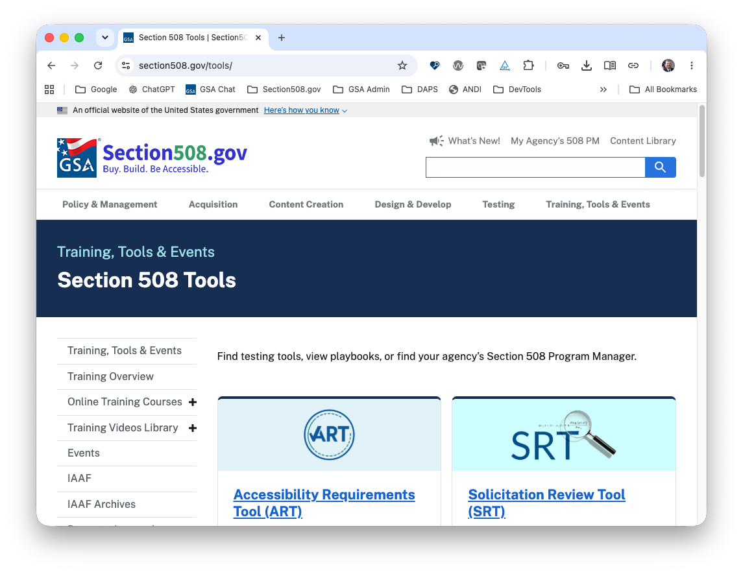
Section 508 Tools & Tools for Testing ICT
Section 508 Tools:
ART
SRT
ACR Editor
Content Library
Tools for Testing ICT:
ANDI
Browser developer tools
Color contrast inspection
Sample size calculator
How-to Videos:
ANDI
Color contrast checkers

Slide 19
Resources and Links
Section508.gov
What’s New
Section508.gov Content Library
Technology Accessibility Playbook
Sample vs Comprehensive Section 508 Conformance Testing
IT Accessibility Policy Framework
Accessibility Risk Management and Model for ICT
Sample Personas for Users With Disabilities
Agile Roles Section 508 Task Matrix
Incorporating Accessibility Conformance Validation within Development Processes
Section 508 of the Rehabilitation Act
Join the Section 508 IT Accessibility Community
For other questions and technical assistance, contact our team at Section.508@gsa.gov.

Slide 20
Questions?

