Slide 1
How USPS is Scaling Accessible Development with Automation & AI
Using AI agents and automation to test and build accessible web applications.

Slide 2




Presenters
Denise Koschmann
Robert Conaghan
Human Factors Engineer Sr Principal
Senior Test Engineer
John Cotter
Tyler Maddox
Senior Test Engineer
Senior Test Engineer

Slide 3
The Problem
❌ Automated tools are limited.
❌ Manual testing takes time and expertise.

Slide 4


It’s like washing dishes…
Manual Testing
Automation

Slide 5
The Goal
✅ More people testing more, earlier.

Slide 6





USPS Approach

Slide 7
Automation
A web automation test framework

Slide 8
What Playwright can do for accessibility testing?
Walk the DOM
Read the accessibility tree
Integrate with Axe Core
Test states (hover, focus, expand)
Test key presses (tab, enter, spacebar)
Enter test data, log in to sites
Manage AI agents
Integrate into CI/CD pipeline
Generate test reports

Slide 9
AI Agents
An AI-powered coding assistant

Slide 10
What can Copilot AI do for accessibility testing?
Learn the tech stack and design system.
Apply WCAG principles.
Identify code issues, make suggestions.
Explain the impact of not fixing.

Slide 11



What can Playwright and Copilot do together?
Look at source code and rendered code (DOM).
Extend Axe Core.
Group related issues.
Understand the report and page context.
Explain who is affected.
Describes fixes based on frameworks used.

Slide 12
Demo: MANTA
Modular Accessibility Node Test Automation

Slide 13
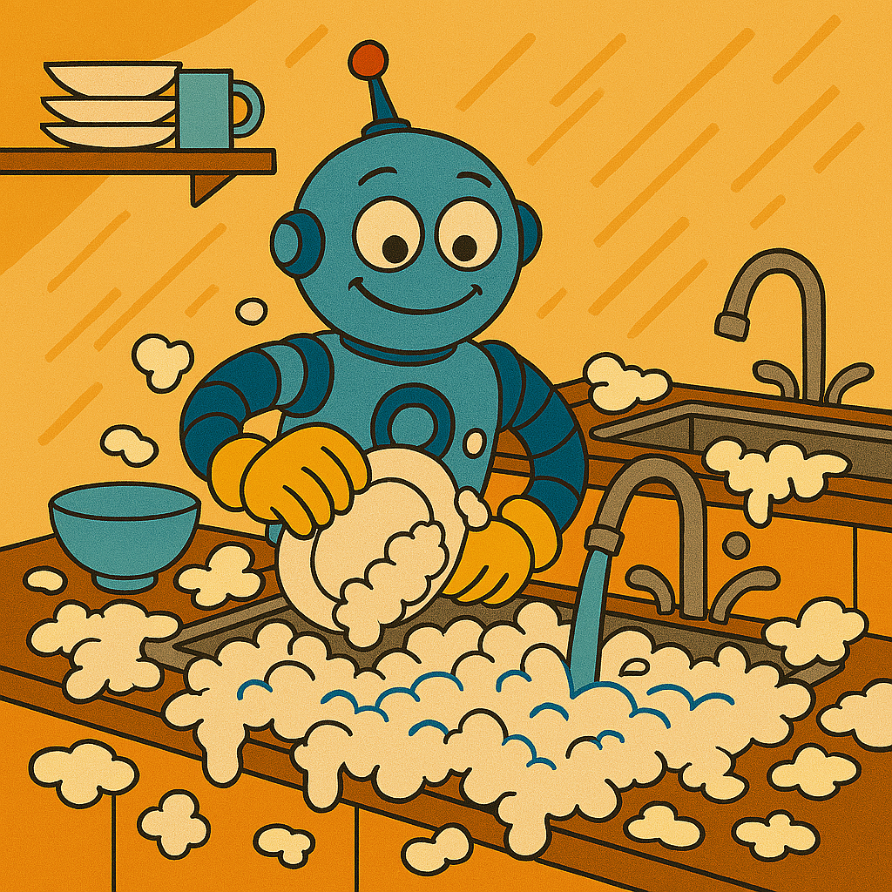
Adding an AI Component: What LLMs Do Today
LLMs will happily and confidently do what you ask… but maybe not in the way that you’d hoped.

Slide 14
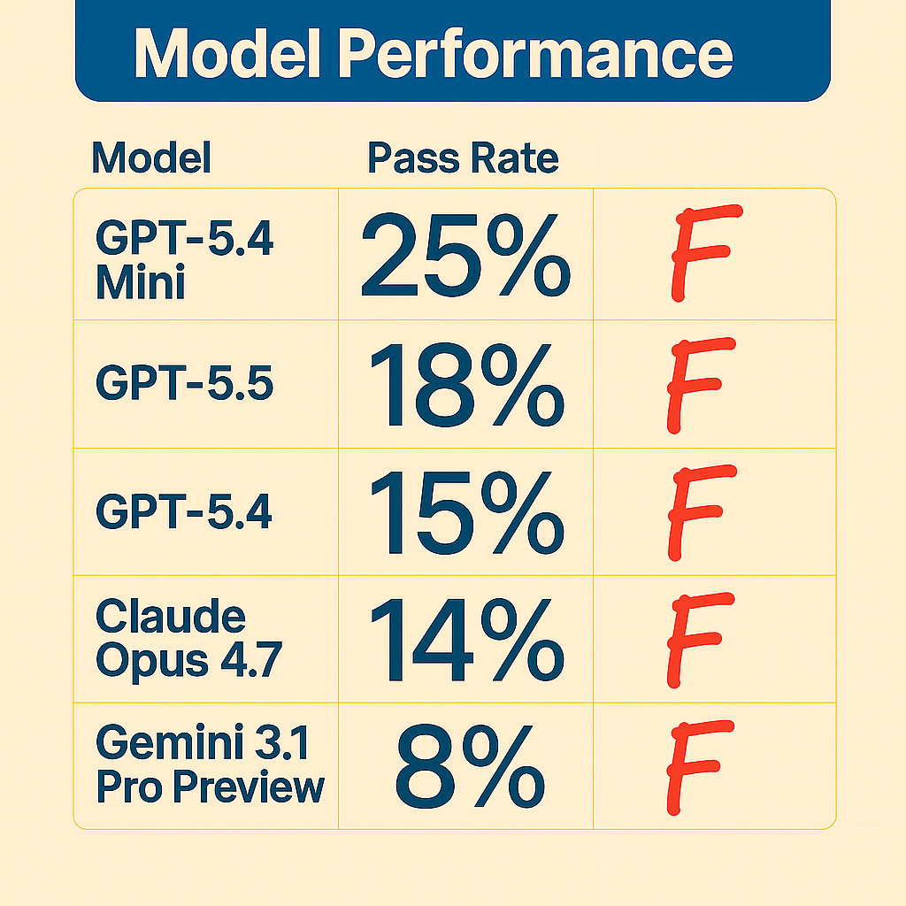
Model Performance Without Accessibility Instructions
LLMs do not produce accessible code by default
Even top models pass only 25% of basic WCAG checks*
Frequent issues: missing labels, invalid ARIA, poor contrast, incorrect roles
* Source: https://microsoft.github.io/a11y-llm-eval-report/

Slide 15
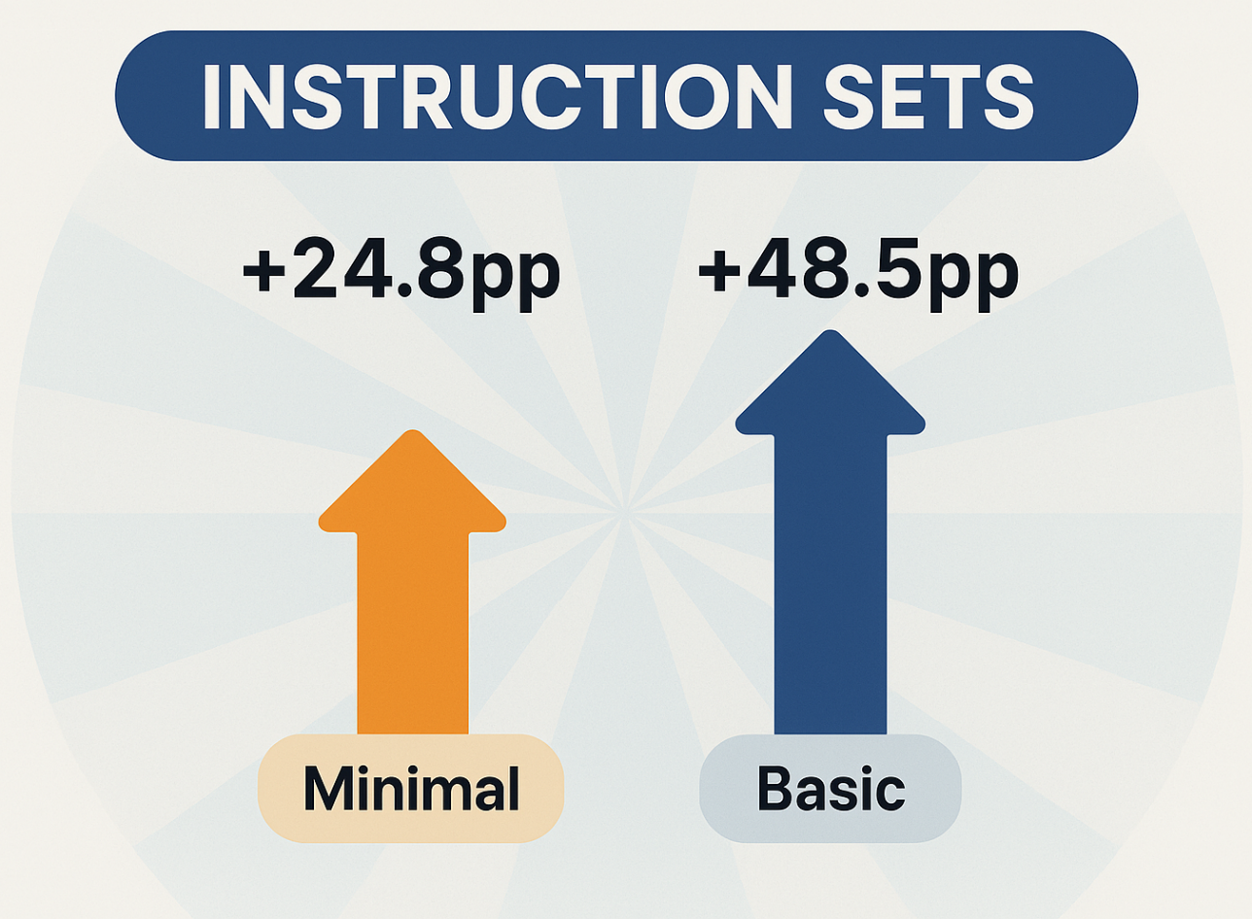
The Power of Simply Asking: Instructions
Adding accessibility instructions to prompts improves results dramatically
Developers get better starting points with little effort
Minimal instructions sets increased average pass rate 24.8pp*
Basic instructions sets increased average pass rate 48.5pp*
* Source: https://microsoft.github.io/a11y-llm-eval-report/

Slide 16
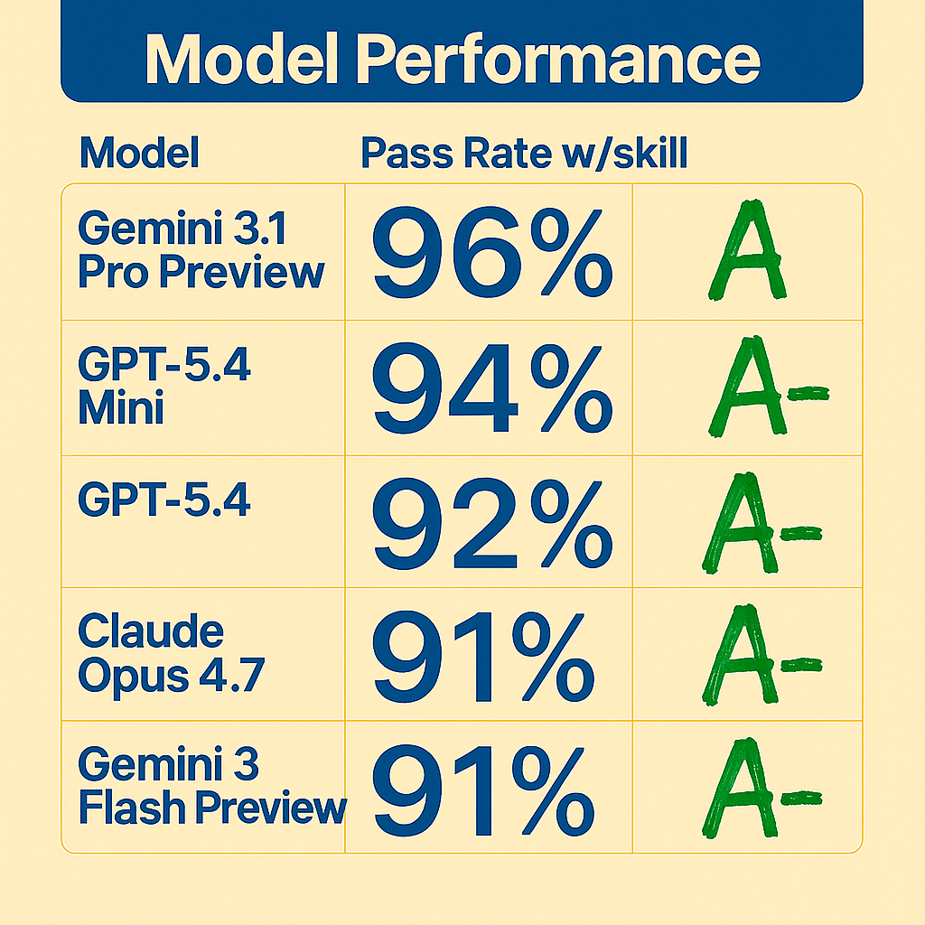
The Power of Simply Asking: Skills
Skills can provide rich context and multi-turn prompting
Average 70pp higher pass rate than control during initial code generation*
Average additional 4pp higher above initial skilled code generation on review/remediate*
Top 5 models with skill all had a final pass rate above 90%*
* Source: https://microsoft.github.io/a11y-llm-eval-report/

Slide 17

AI is *NOT* magic – It is a Tool
Find the right work for this tool
Identify the limits of your existing tools
Go beyond simple prompting to solve new problems

Slide 18

What Are AI Skills?
They Are Building Blocks:
Modular, reusable AI-powered function
Written in markdown (.md)
Handles one clear, focused task
Integrates well with systems

Slide 19
What Makes an Effective Skill?
ICTOG
  Identity – Who are you working with?
  Context – What information is relevant?
  Task – What are they doing for you?
  Output – What are they producing?
  Guardrails – What is off-limits to them?

Slide 20
Demo: Agent Skills Extend Reporting Capabilities

Slide 21
AI Skills - /508-Cluster
Problem Statement: Remediating with automation report is inefficient because separate violations often share the same root cause.
Identity: Senior Accessibility Tester
Context: Automation report (JSON), live DOM
Task: Cluster accessibility violations by shared cause/components & reprioritize
Output: JSON artifact > HTML report
Guardrails: Do not write/propose code, Git push, etc.

Slide 22
AI Skills - /508-Fix
Problem Statement: Remediation fixes are at the violation level after clustering and do not address the specific tech stack.
Identity: Senior Frontend Dev (Accessibility Specialist)
Context: Automation report (JSON), 508-cluster output (JSON), local codebase/live DOM
Task: One upstream fix per cluster
Output: JSON artifact > HTML report
Guardrails: Propose code changes (HITL)

Slide 23

Building with AI
Skill Orchestration:
Coordinate multiple AI skills to scaffold a shared context
Choreograph workflows to solve problems
Keep AI systems predictable, efficient, and anchored

Slide 24

Does it scale? Yes.
Your expertise, expanded:
Agents encode domain knowledge
Structured prompts and guardrails enforce consistency and security
Automated scanning detects issues early
AI‑generated remediation accelerates fixes
Contextual instructions reduce ambiguity and improve outcomes

Slide 25
AI-Guided, Human-Validated: The Long View
AI handles repetitive checks
Building in context increases what can be caught by automation
Specialists cover more ground, focus on complex issues
Teams deliver quality, inclusive products at scale

Slide 26
Questions?

Slide 27
Demo: DART
Document Accessibility Remediation Toolkit

Slide 28
GDIT – Art of the Possible
Contact: Nadereh Nasir
Section508@usps.gov

