Slide 1

WILSON 508
Compliance Demo
Automating accessible document remediation for Federal teams
For Official Federal Government Use Only
This pre-decisional, privileged, and confidential information is for internal government use only, and must not be disseminated, distributed, or copied to persons not authorized to receive the information. Unauthorized disclosure may result in prosecution to the full extent of the law

Slide 2

The Problem
Many digital content, tools, and technologies are not 508 compliant. When barriers exist, people can’t access information, complete tasks, or participate fully.
508 COMPLIANCE
WHO IS AFFECTED?
HOW THEY ARE AFFECTED
Section 508 of the Rehabilitation Act requires federal agencies to make their electronic and information technology accessible to people with disabilities.
People with disabilities temporary, situational, or permanent across all walks of life.
When digital content is not 508 compliant, people may experience barriers that can:
Prevent Access
Unable to access important information.
Cause Delays
Tasks take longer.
Create Frustration
Difficult to navigate or understand.
Limit Participation
Exclusion from services and opportunities.
Result in Inequity
Unequal access hinders independence.
✓ Perceivable
✓ Operable
✓ Understandable
✓ Robust
508 compliance removes barriers and creates equal access for all.
Mobility
Vision
Hearing
Cognitive
Neurological
Disabilities may be visible or invisible. Everyone benefits from accessible design.
Document accessibility is required but manual remediation is slow, repetitive, and difficult to sustain at scale.

Slide 3
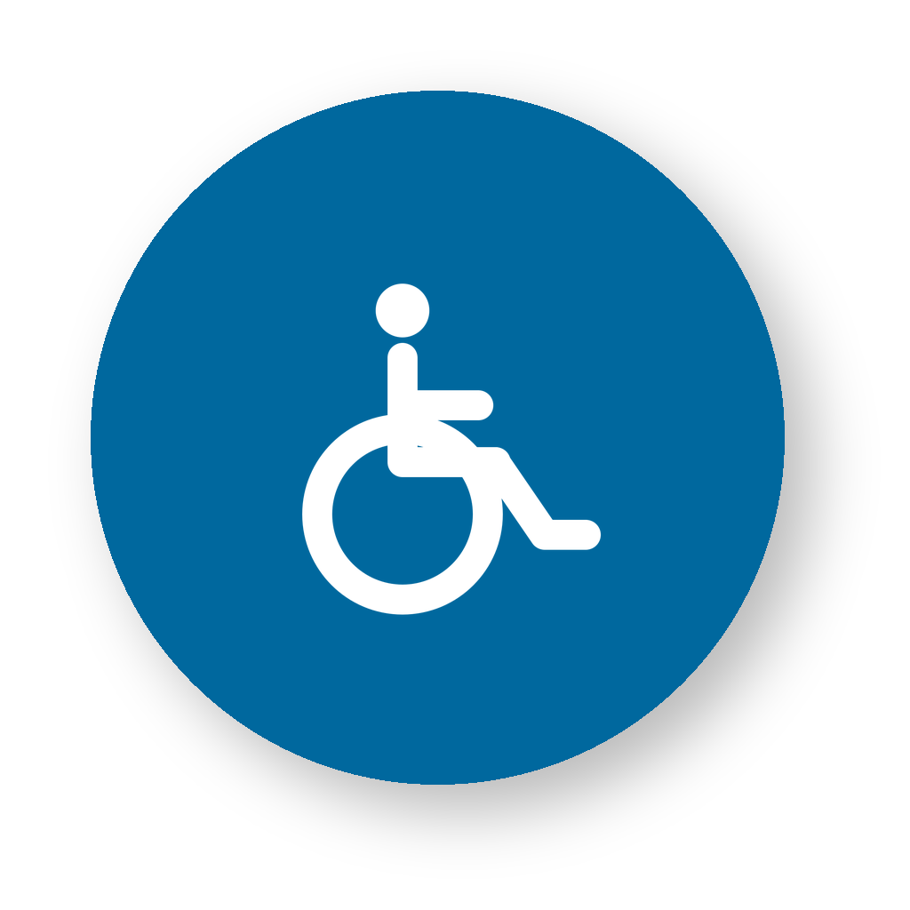


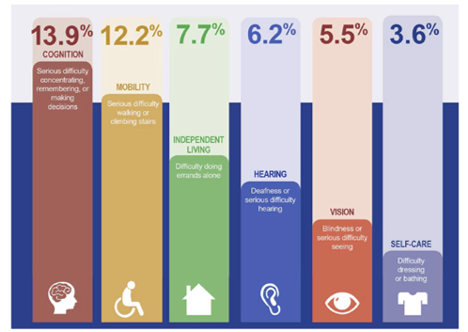
Disability Affects All of Us
Accessibility is not an edge case. It supports employees, partners, and the public across a broad range of access needs.
70M+
U.S. adults reported having a disability
PERMANENT
TEMPORARY
SITUATIONAL
LONG-TERM
SHORT-TERM
CONTEXTUAL
Lifelong access needs such as blindness, low vision, deafness, or mobility disabilities.
Injury, illness, recovery, or medication side effects limiting access for a period of time.
Glare, noise, low bandwidth, or using a mobile device create temporary access barriers.
Designing accessibly from the start reduces barriers for everyone, not just people who disclose a disability.
Source: CDC DHDS/BRFSS 2022 update; FY 2025 Governmentwide Section 508 Assessment.

Slide 4

Accessibility Is Required
Section 508 makes accessibility a federal requirement, not a best-effort activity.
FEDERAL MANDATE
REWORK & DELAY
EQUAL ACCESS
LEGAL REQUIREMENT
OPERATIONAL RISK
MISSION IMPACT
Federal agencies must develop,
procure, maintain, and use
accessible information and
communication technology.
Inaccessible documents create
rework, delay distribution, and
require remediation before use.
Accessible content helps
employees and the public receive
comparable access to
information and services.
Build accessibility into the process before content is posted, shared, or distributed.
Sources: HHS Digital Accessibility FAQs; Section508.gov guidance.

Slide 5




Violation Can Be Costly
Violations can lead to complaints and, ultimately, to litigation against agencies found to be in non-compliance.
Section 508 requires federal agencies to make ICT accessible and provide comparable access to information and data.
Individuals with disabilities may file administrative complaints alleging agency noncompliance with Section 508.
Complaints can lead to civil action remedies, legal exposure, rework, and delayed release.
Compliance reduces complaint risk and supports comparable access for employees and the public.

Slide 6

It’s the Law, and the Right Thing to Do
Accessible source documents make accessible PDFs easier, faster, and less expensive to produce.
62%
of tested electronic documents were not fully conformant
EXPORT
TO PDF
REVIEW &
CHECK
STEP 1
STEP 2
STEP 3
CREATE
CONVERT
VALIDATE
Use accessible headings, lists, tables, links, and alt text in the source file.
Preserve document structure when exporting to PDF.
Check reading order, tags, contrast, metadata, and errors before release.
Remediation after publication costs more time. WILSON helps shift compliance left, earlier in the document lifecycle.
Source: FY 2025 Governmentwide Section 508 Assessment, Table 5 (38% fully conformant).

Slide 7



It’s Not a People Problem
Most accessibility gaps come from process gaps, not a lack of intent.
?
TRAINING GAP
OWNERSHIP GAP
CAPACITY GAP
CONSISTENCY GAP
KNOWLEDGE
ACCOUNTABILITY
BANDWIDTH
ALIGNMENT
"I was never trained."
"No one asked me to do it."
"It takes so much time."
"I do it, but I wish everyone else did too."
Automation helps turn good intentions into repeatable practice.

Slide 8

The Solution: WILSON 508
Workplace Intelligence Learning Software Optimization Neutralizer (WILSON) identifies and remediates documents against Section 508 rules, reducing compliance risk and manual review hours.
WILSON is designed to support the
OFM HIGLAS program 508 documentation compliance program through automation.
WILSON is built in accordance with the 508 compliance rules provided by HHS and the Accessibility Electronic Document Communities of Practice (AEDCOP) of the Federal CIO Council
WILSON Bot processes around 200+ rules in total for all the versions of Microsoft Office and Adobe.
WILSON leverages other technologies such as Artificial Intelligence (AI) and Natural Language Processing (NLP).
WILSON Provides Outputs
Accurate, consistent, and efficient 508 compliance results that help ensure accessible and inclusive digital content
Case study: 508 remediation

Slide 9
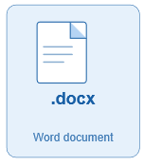
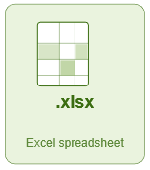
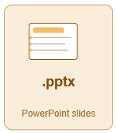
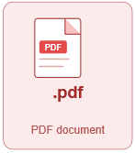
WILSON Demo
Demonstration flow
1
Select
2
Run
3
Review
Choose the document or folder for review.
WILSON checks and remediates supported accessibility rules.
Open the remediated document and error-handling report.
Supported file types that WILSON can review & remediate
The user is able to focus on other priorities while the bot runs.

Slide 10
What WILSON Can't Do
WILSON accelerates remediation, but it does not replace human quality control. Users must review both the output file and the execution log file before release.
PPTX
Sample output file
XLSX
Sample execution log file
WILSON_Remediated_Output.pptx
WILSON_Execution_Log.xlsx
Review the PowerPoint output to confirm the remediated content, layout, reading order, alt text, and final 508 quality.
Review the Excel log for all remediation steps that occurred during processing, plus any errors, warnings, or items WILSON could not remediate.
User responsibility: WILSON provides remediation support and transparency; the user still validates and approves the final output.

Slide 11
WILSON Bot Usage
WILSON usage to date demonstrates measurable reduction in manual 508 remediation workload and creates a repeatable audit trail for processed documents.
4,094
2,126
$174K
DOCUMENTS
HOURS SAVED
LABOR COSTS
TOTAL PROCESSED
HOURS AVOIDED
COSTS AVOIDED
Documents remediated through WILSON since inception
Estimated remediation hours avoided through automation
$174,584 in estimated labor costs avoided since inception
WILSON is already returning capacity to the team, but the author's final review is still required before any document is released.

Slide 12
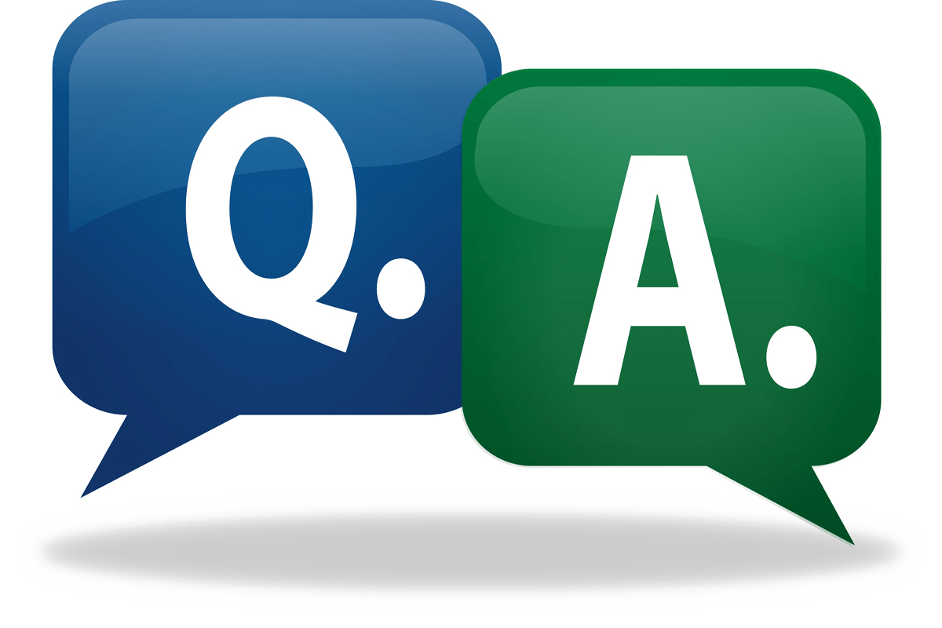
Q&A
Questions?
Thank you for helping make federal information accessible from the start.

